Slide 1
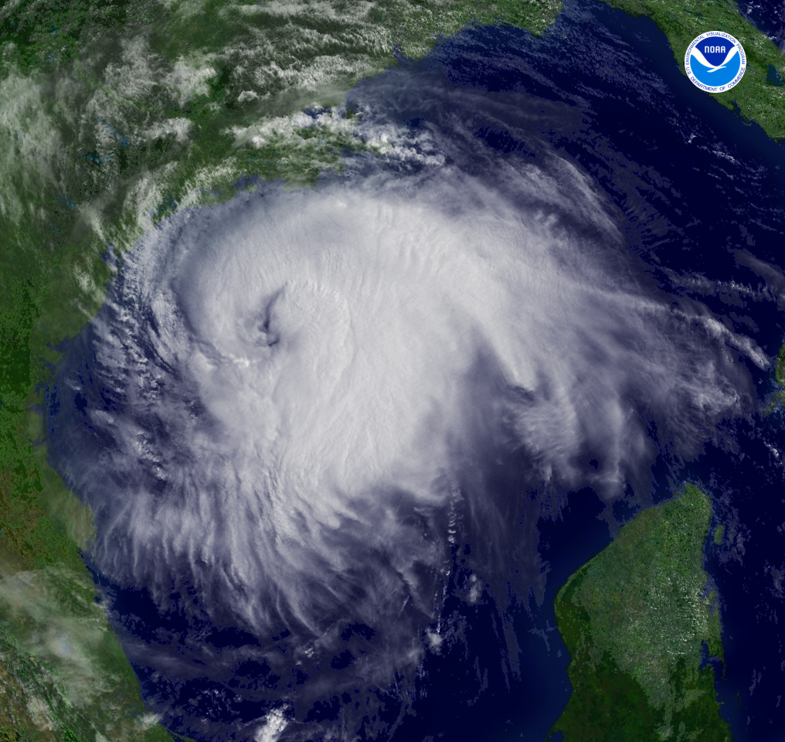
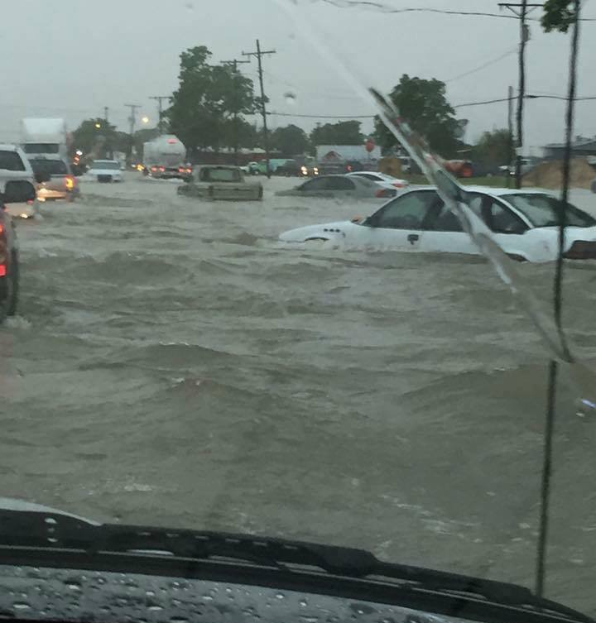
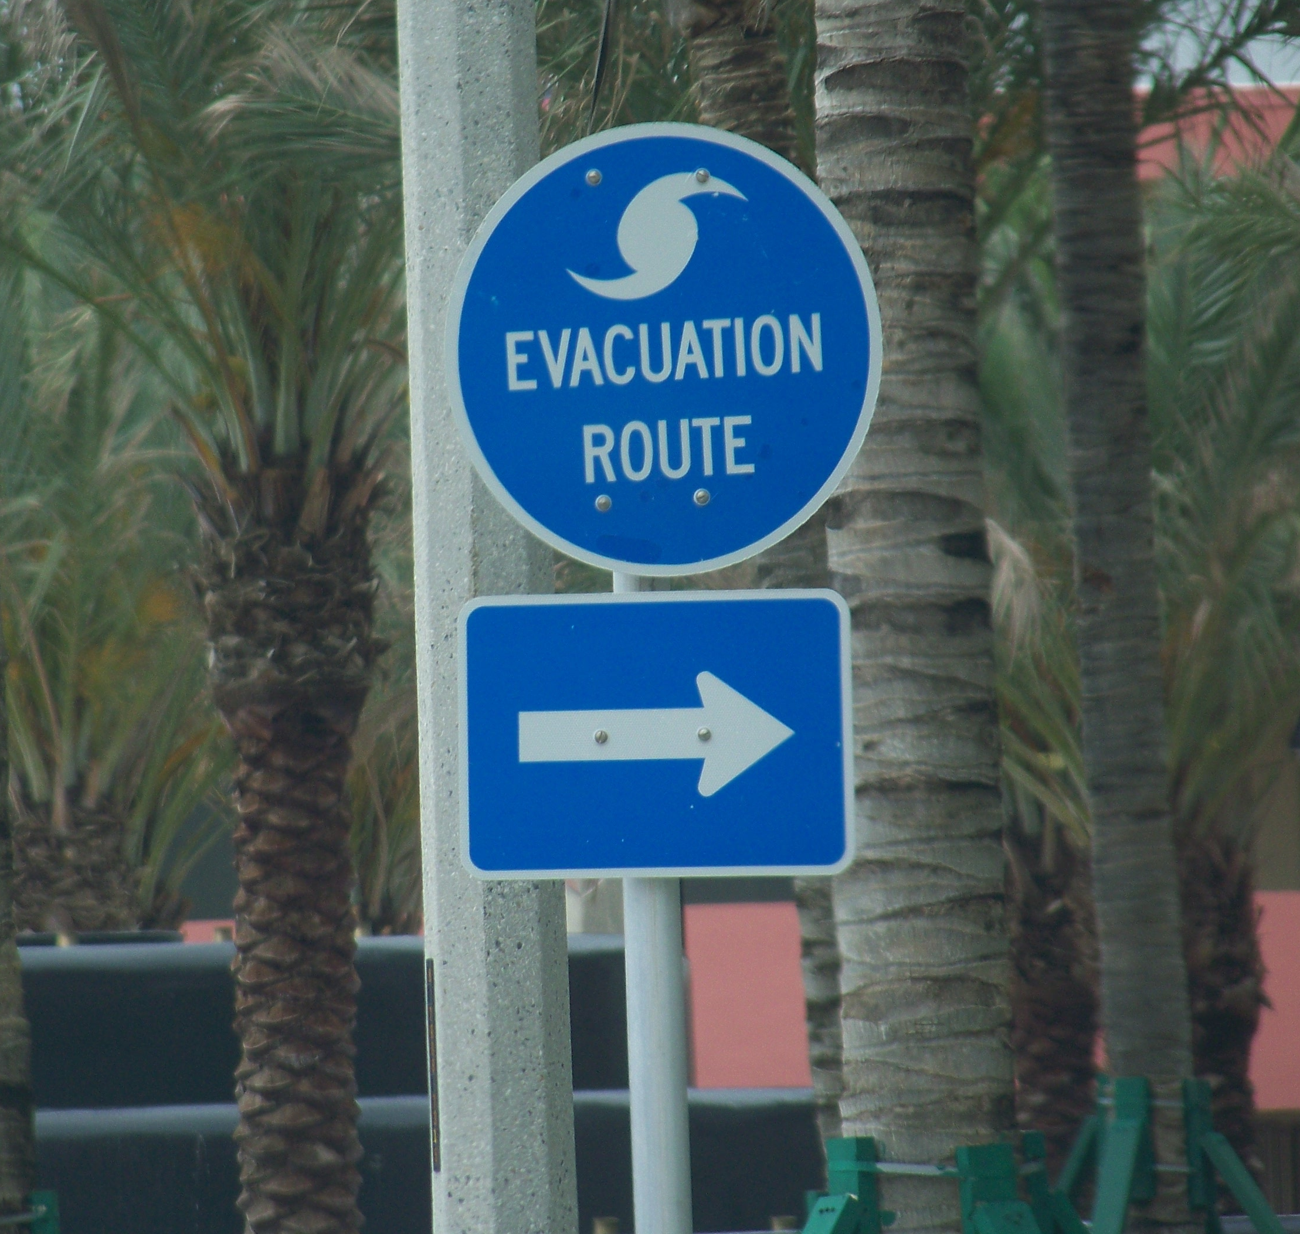

Flood & Hurricane Preparedness
Texas Gulf Coast Maintenance & Operations Meeting
April 13, 2017
Melissa Huffman, Meteorologist
National Weather Service – Houston/Galveston, TX

Slide 2
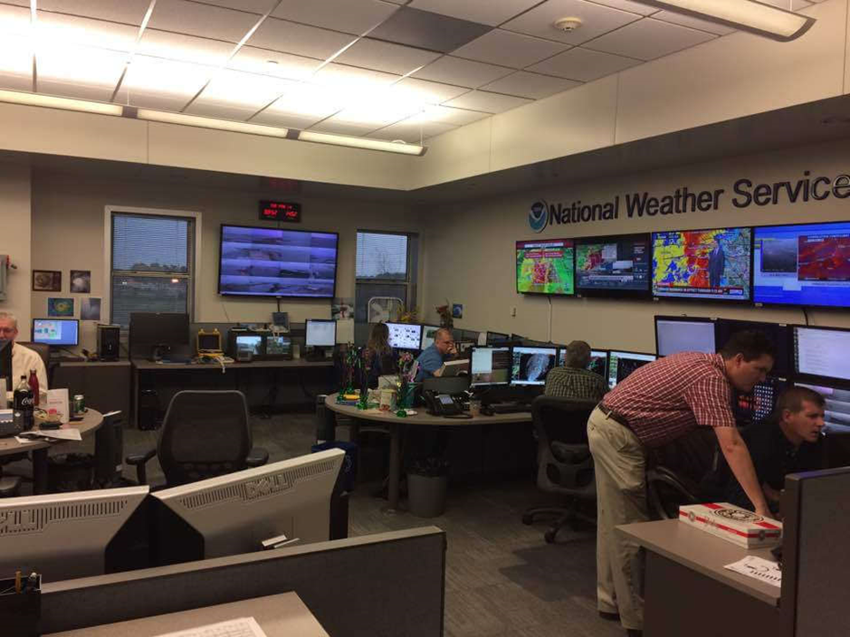
Who is the National Weather Service?

Slide 3
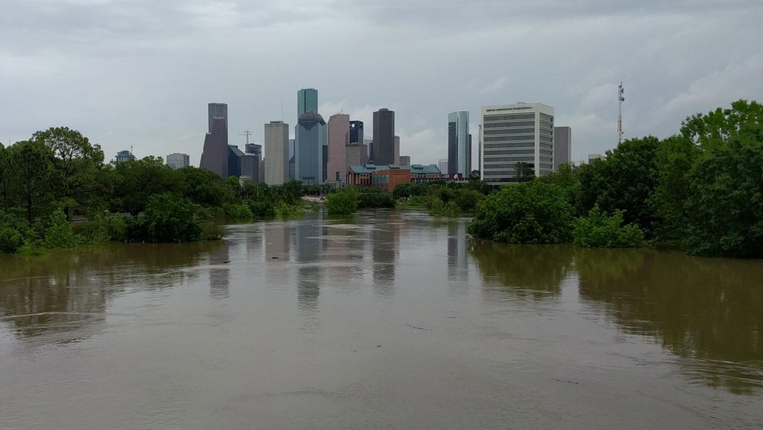
River & Flash Flooding

Slide 4
River & Flash Flooding

Slide 5
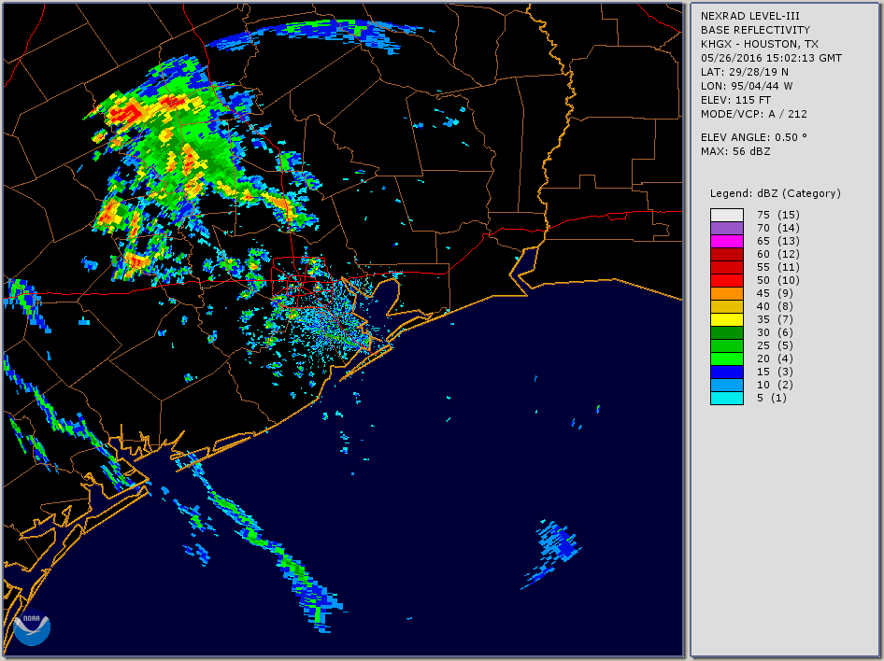
Event Overview
Brenham
Houston

Slide 6
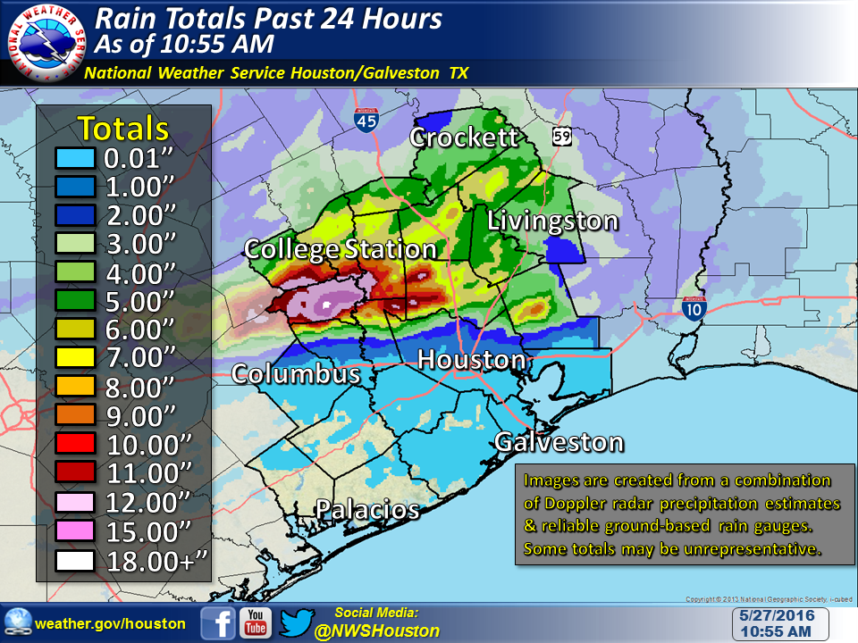
May 26-27 Rain Totals

Slide 7
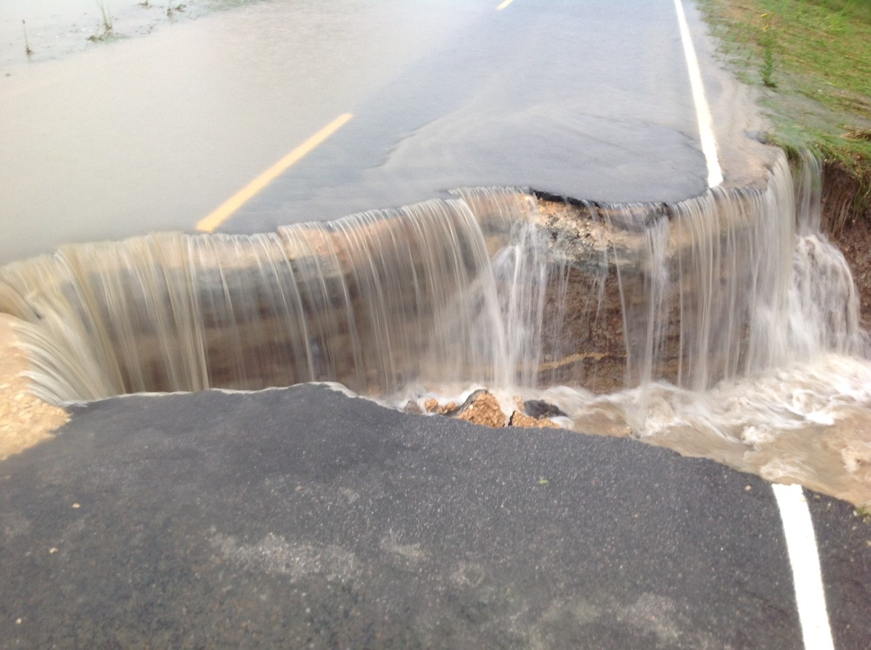
How Common Are Events Like This?
Top 10 One Day Rainfall Events for Brenham, TX
Rank | Amount (in.) | Date
1 | 20.50 | May 27, 2016
2 | 10.38 | October 17, 1994
3 | 10.25 | October 18, 1998
4 | 10.02 | October 3, 1902
5 | 8.76 | June 29, 1899
6 | 7.28 | March 13, 1946
7 | 7.08 | June 23, 1921
8 | 6.88 | October 25, 2015
9 | 6.85 | September 12, 1961
10 | 6.46 | April 28, 1972
Period of record: January 1, 1897 to October 19, 2016

Slide 8
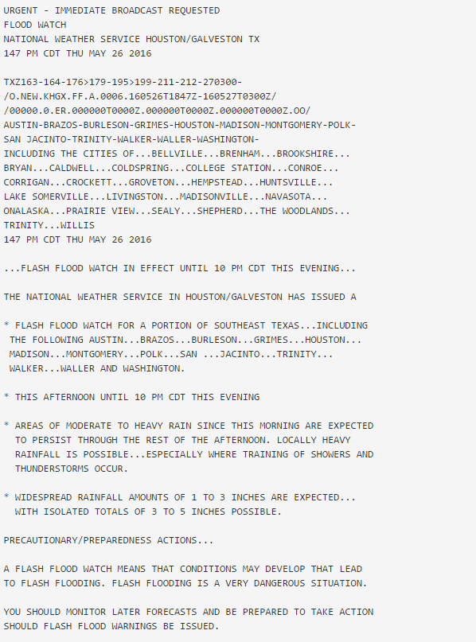
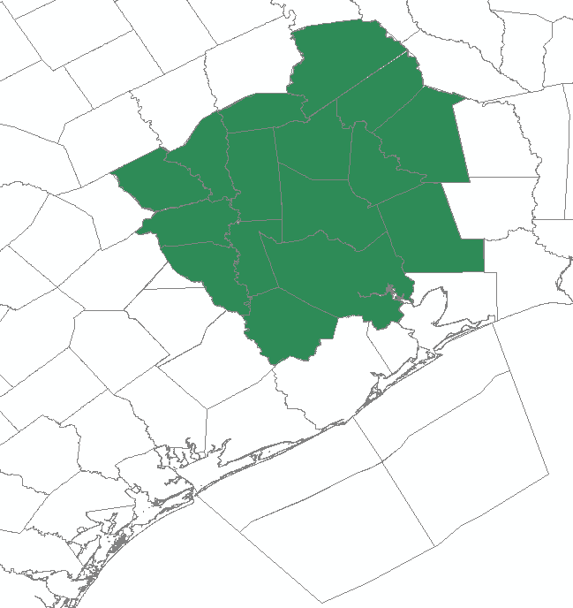
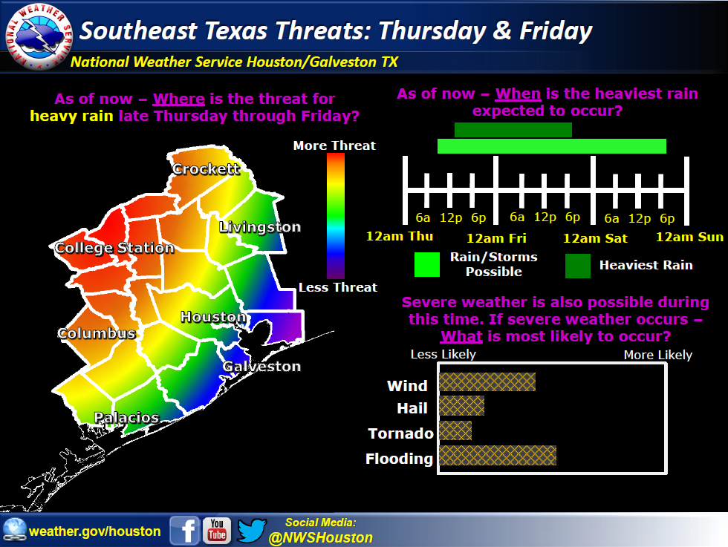
Flash Flood Watch
Crockett
Huntsville
Brenham
Cleveland
Houston
Where?
When?
What?

Slide 9
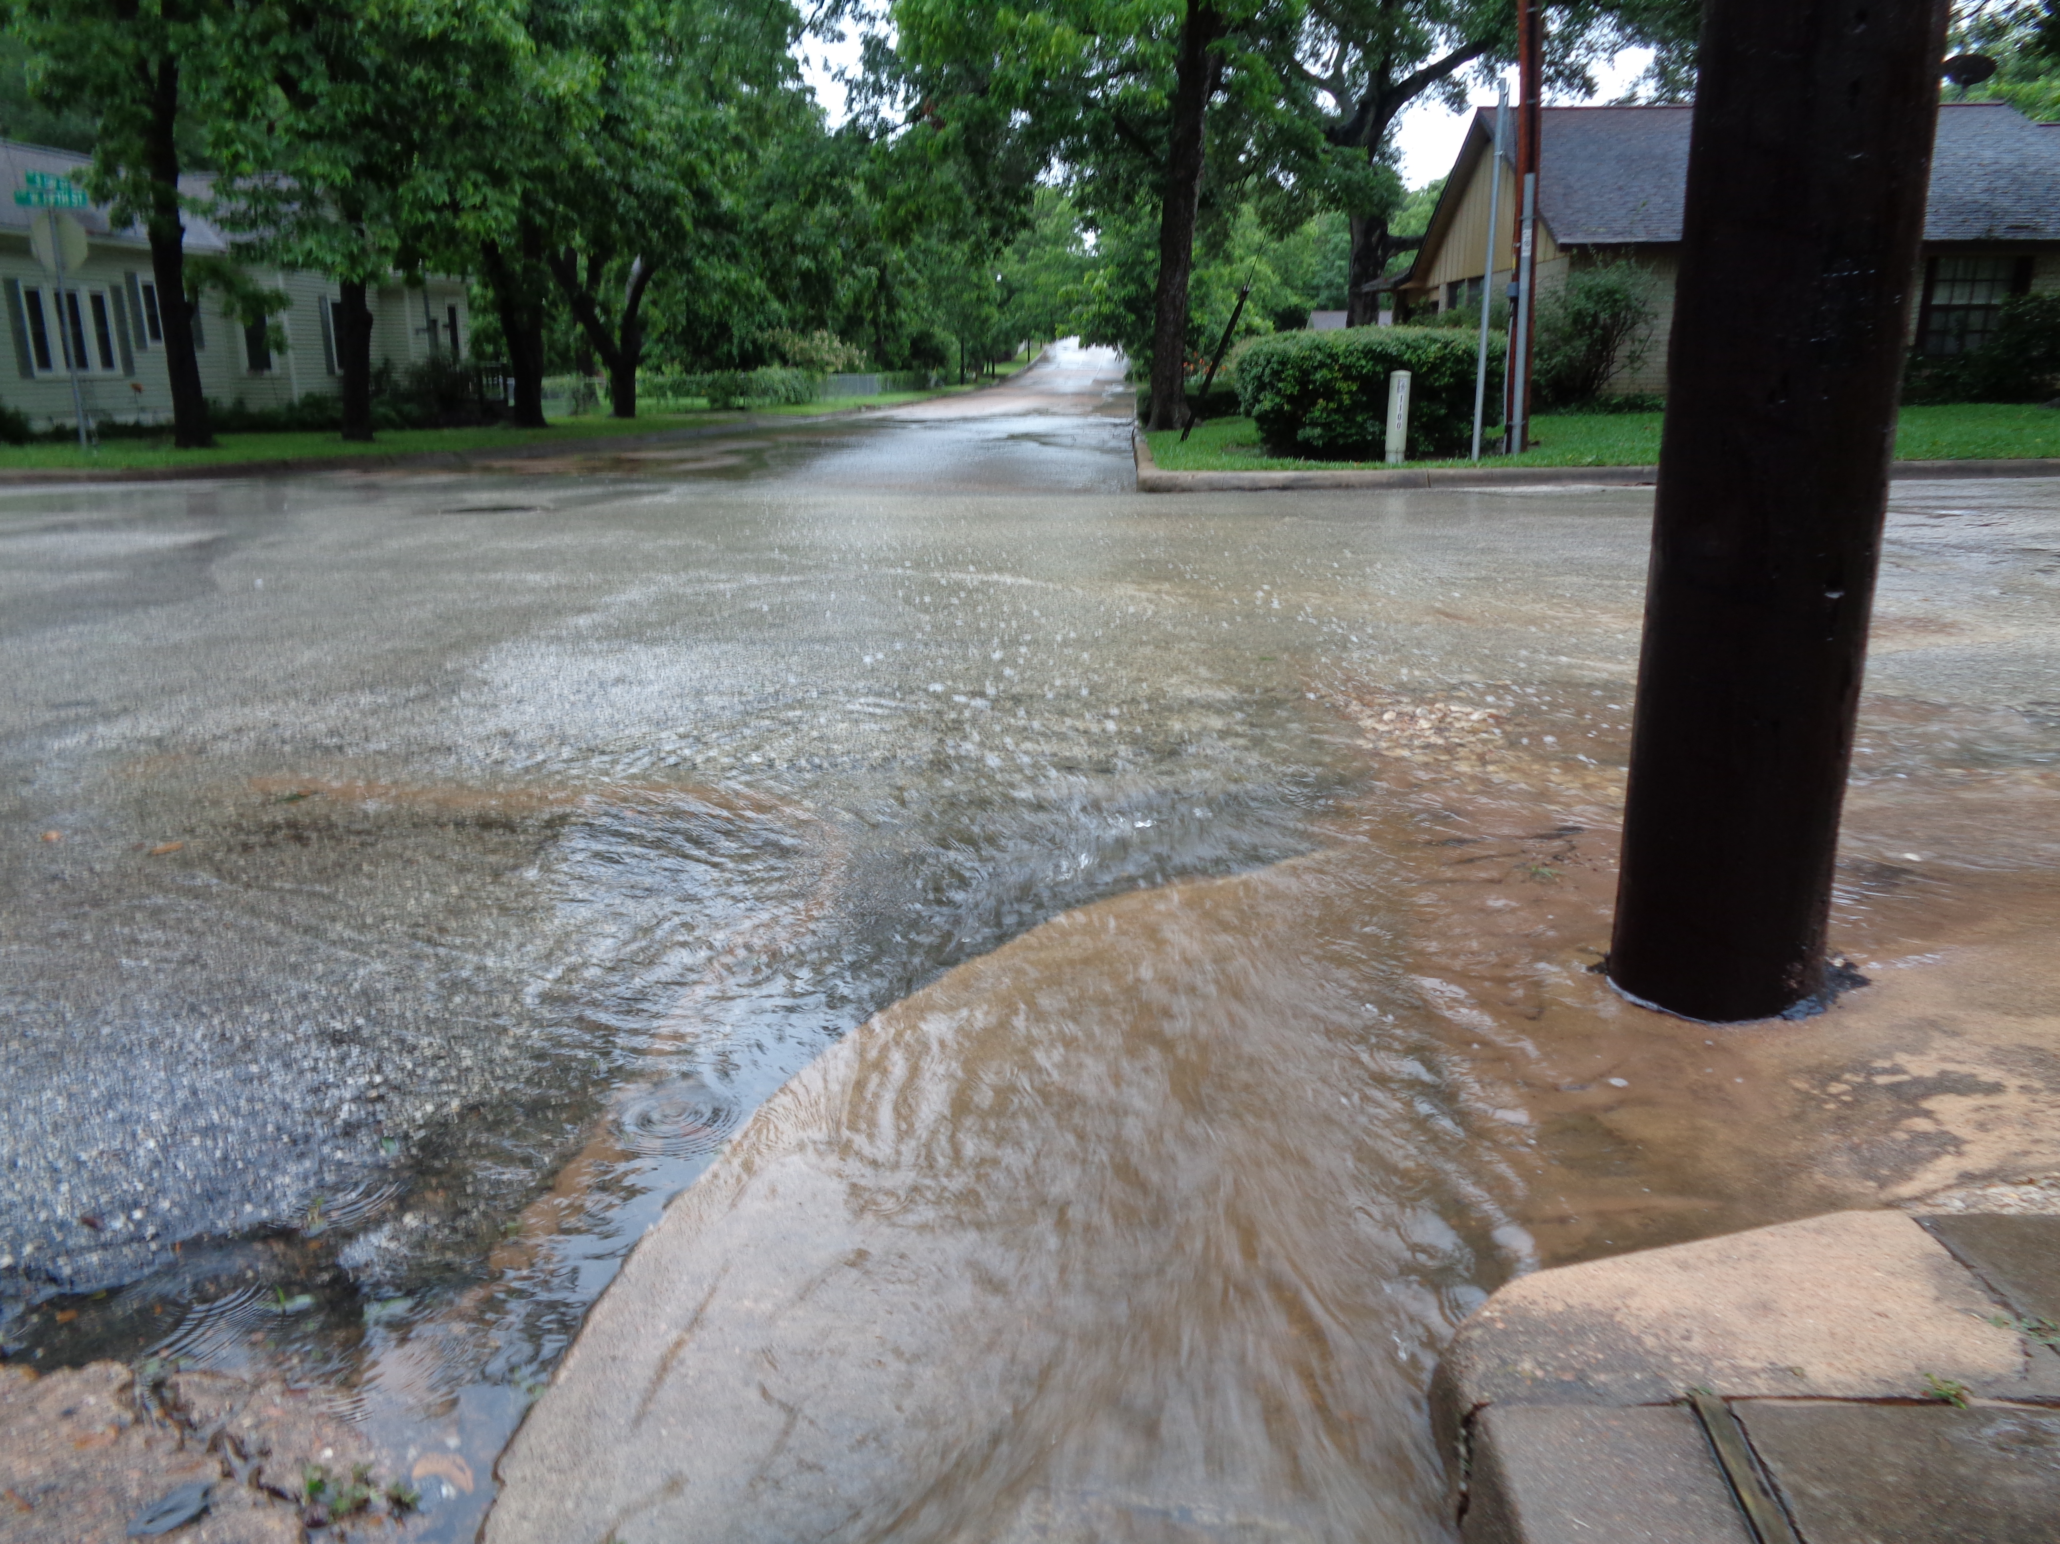
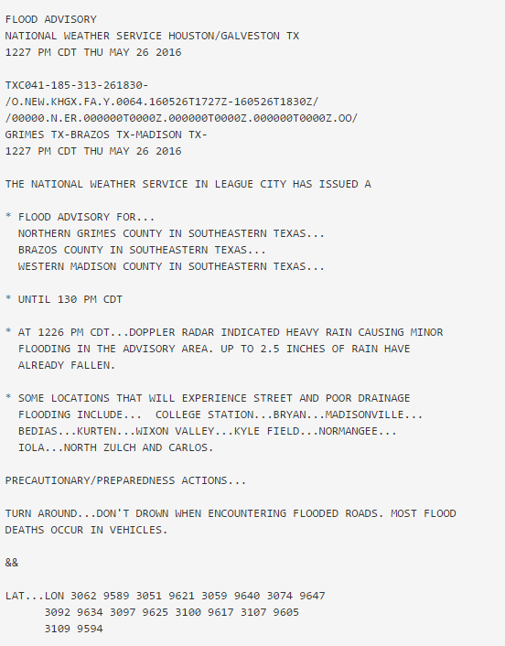
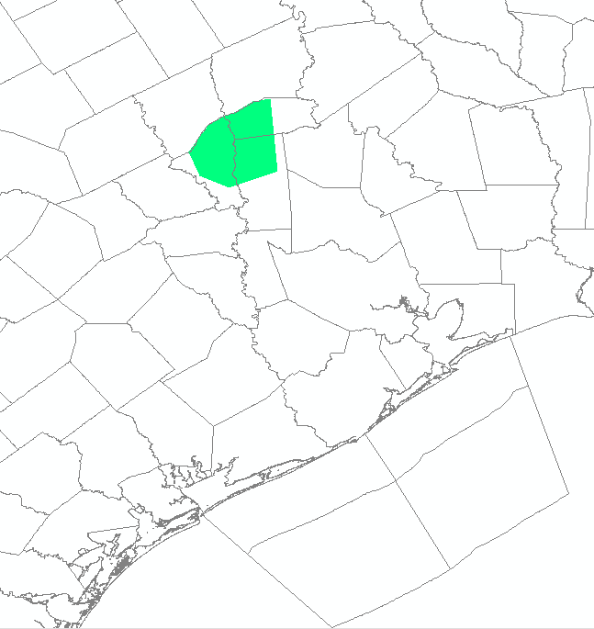
Flood Advisory
Crockett
Huntsville
Brenham
Cleveland
Where?
When?
Houston
What?

Slide 10
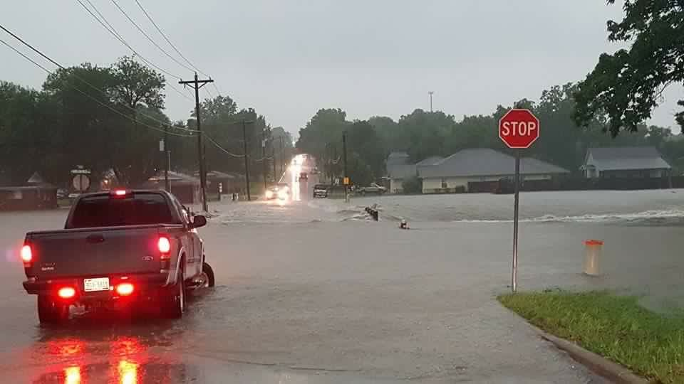
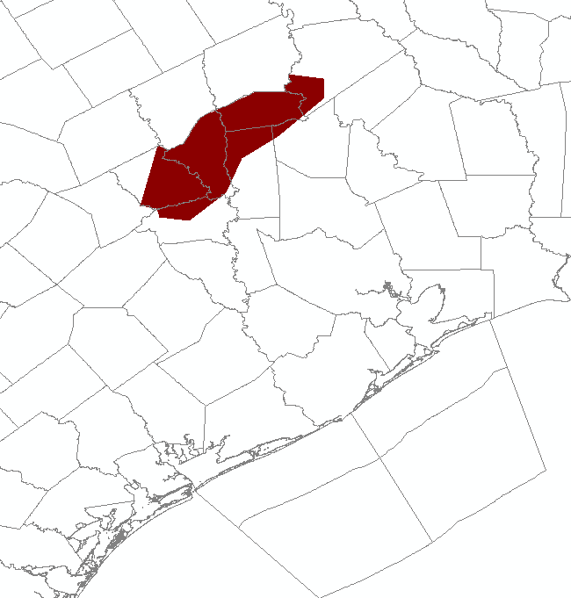
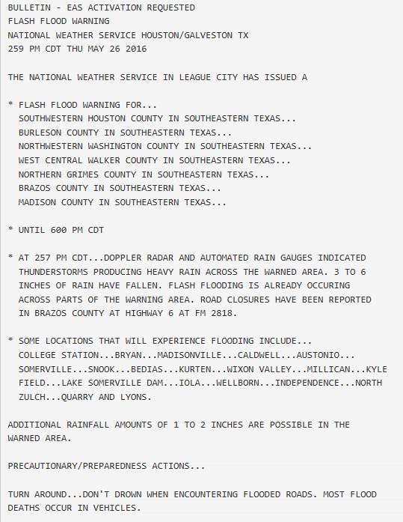
Flash Flood Warning
Crockett
Huntsville
Where?
Brenham
Cleveland
When?
Houston
What?

Slide 11
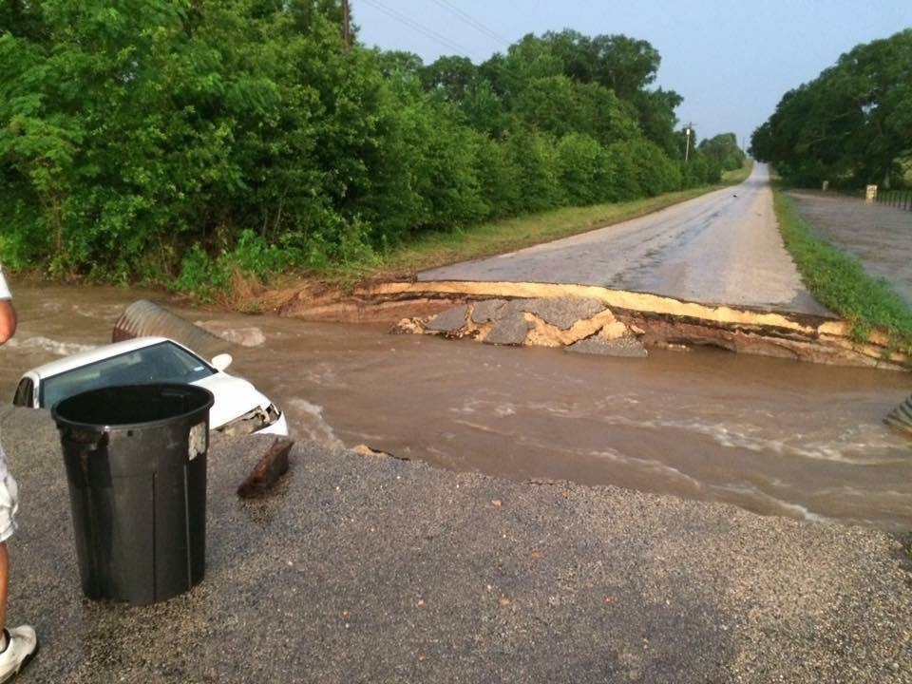
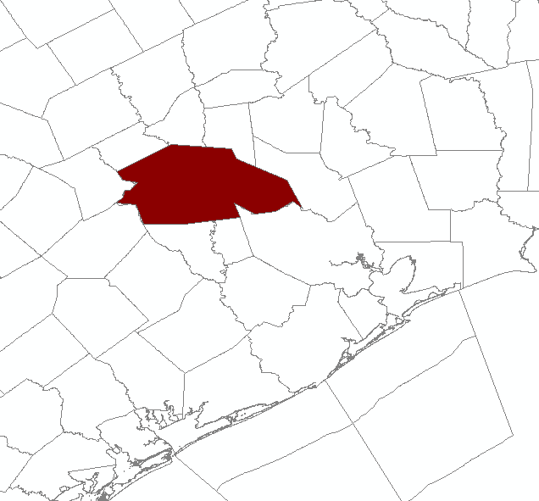
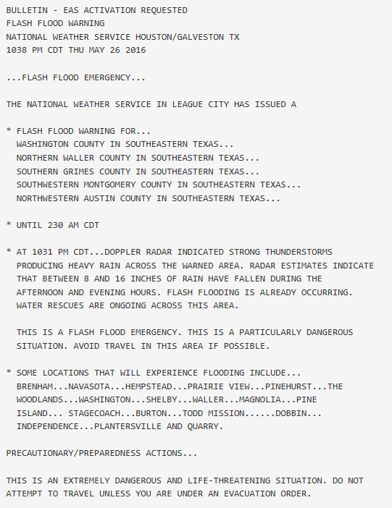
Flash Flood Emergency
Crockett
Huntsville
Where?
Cleveland
Brenham
When?
Houston
What?

Slide 12
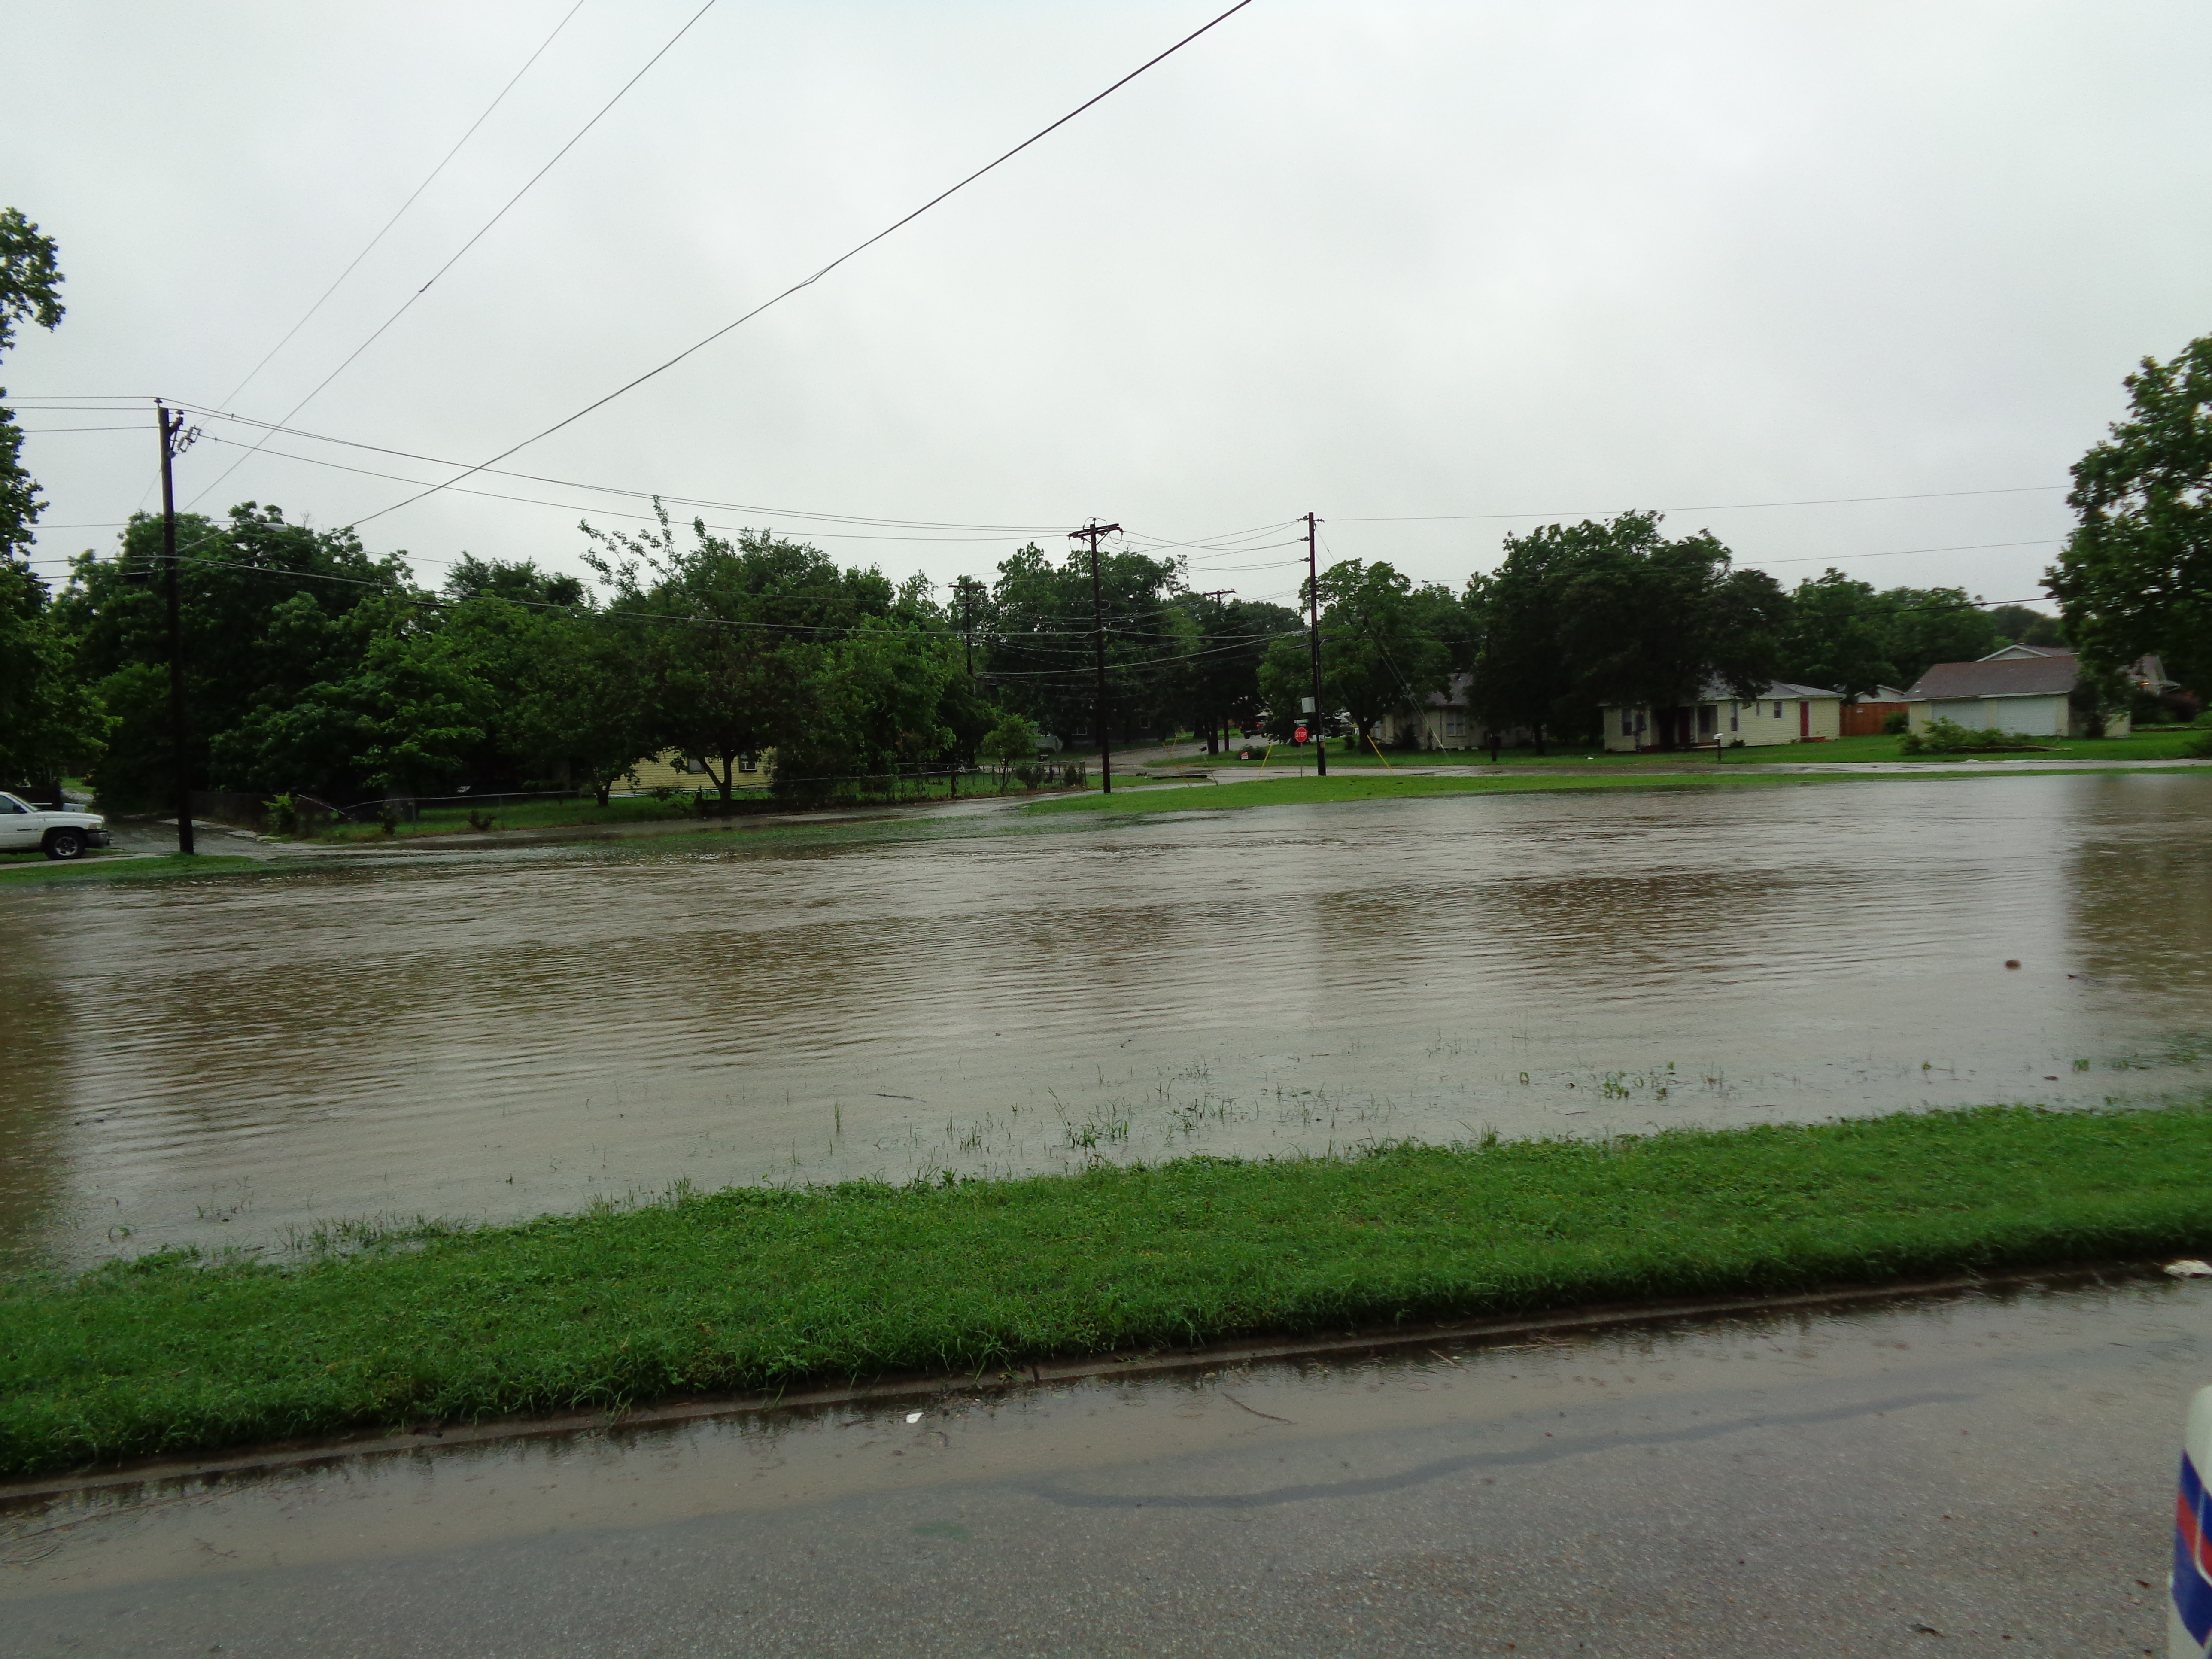
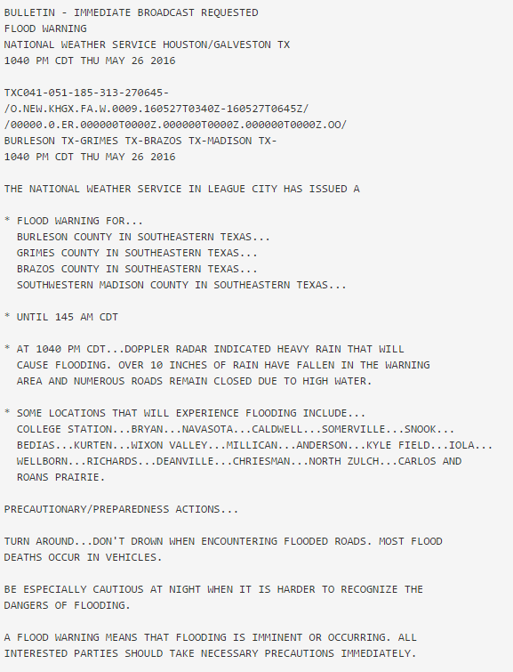
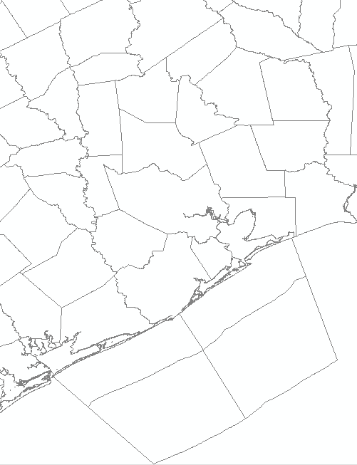
Areal Flood Warning
Crockett
Huntsville
Brenham
Cleveland
Where?
When?
Houston
What?

Slide 13
Wading Through Flood Products
Flash Flood Watch
Flash or Areal Flood Warning
Before Event Onset
Flood Advisory
Flash Flood Emergency
River Flood Warning
Increasing Impact Potential
ALL Situations Represent Threatening Conditions to Life and/or Property
Note: Flooding can (and does) occur without a Flash Flood Watch!

Slide 14
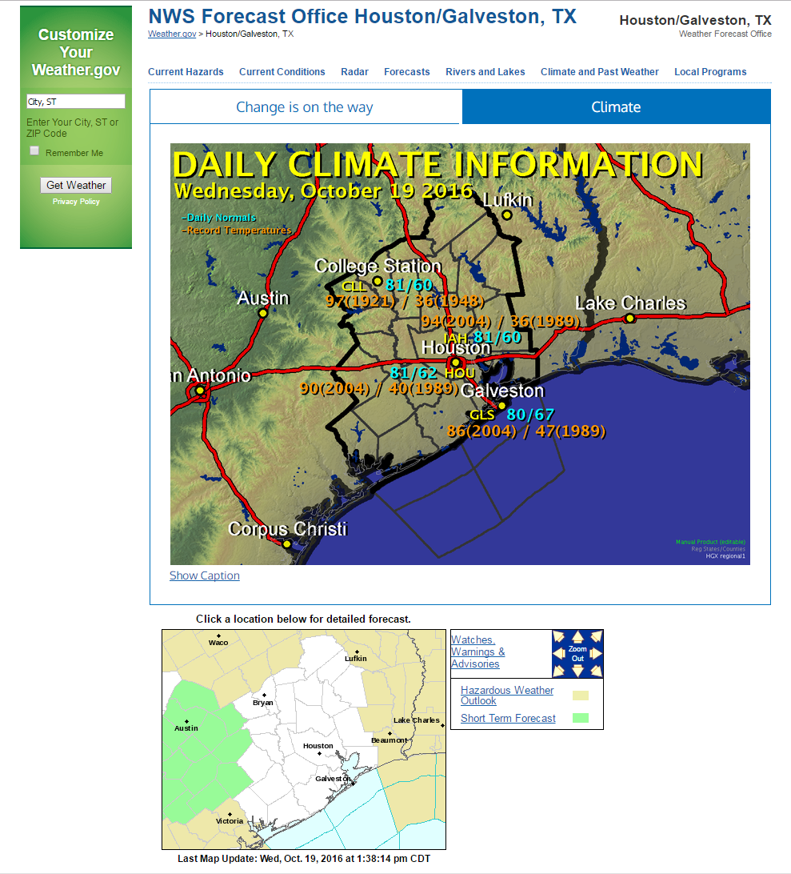

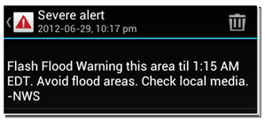
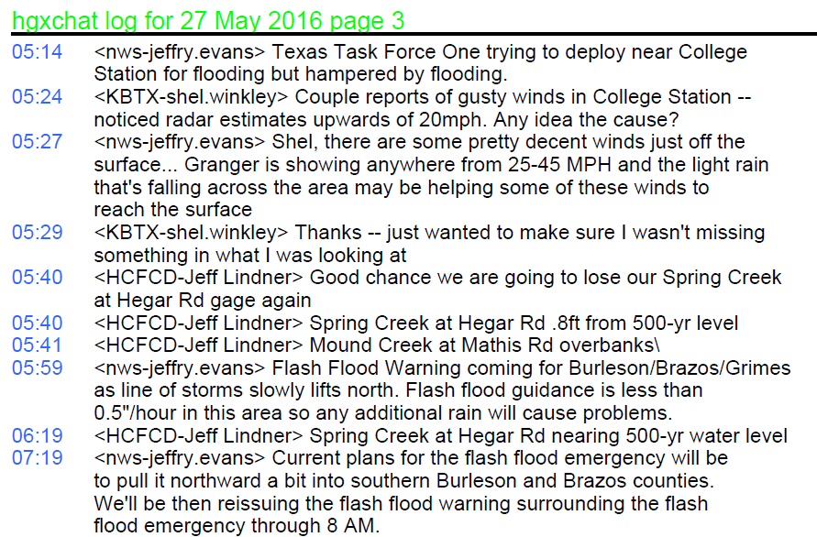
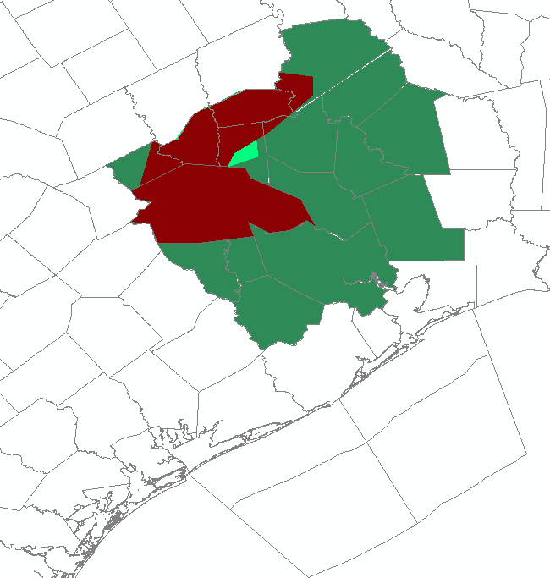
Where to Find Warning Information
Website
NWSChat
Wireless Emergency Alerts (WEA)
iNWS
www.weather.gov/houston

Slide 15
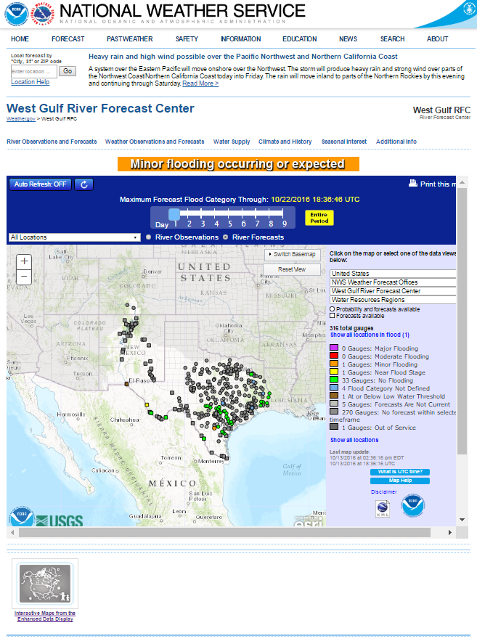
River Forecast Center Website Features
NATIONAL HEADLINES AND TABS: The National Headline for weather for the day posted on top. The tabs at the top of the page route to National Forecast Centers and NOT local information
RIVER FORECAST CENTER TABS: These tabs link to more information directly from the River Forecast Center including extended outlooks, a quick briefing page, access to precipitation data, etc.
HYDROLOGY OF THE DAY: The highest forecast threshold for the next 5 days
THE MAP: Colors represent the level of flooding for each site. Hovering your mouse over these sites will bring up the latest hydrograph for that site. Clicking on the site will take you to the individual site forecast page (more on that later). Those sites that are gray do not have an active forecast but you can still see their current observations.
The slider bar at the top allows you to scroll through the days to see the level of flooding around the state. Forecasts typically only go out 5 days, but when necessary extended forecasts are provided.
NOTE: This is a new website with a new design, many new features will be added over the coming months
LINK TO ENHANCED DATA DISPLAY: A place to see many layers of data on one map
www.weather.gov/wgrfc/

Slide 16

Hydrograph Basics
LOCATION: Of the gage the forecast is made, AT means the gage is in the limits of the town/city, NEAR or NR means that town/city has the closest post office
STAGE VS FLOW: Hydrologists, models, reservoirs work in flow. Emergency managers, media, general public work in stage…sometimes
What is flow or a cubic foot per second?
A basketball is roughly a cubic foot, so 20,000cfs is 20,000 basketballs of water passing the gage every second.
The USGS measures the flow and the stage at every gage and provides a rating curve linking flow to stage.
OBSERVED: Last 3 days of observations from USGS with the latest observation noted
FORECAST: 5 Day forecast for site that is updated every 6 hours
NOTE: The amount of future (forecast) rainfall included is usually 12 hours.

Slide 17
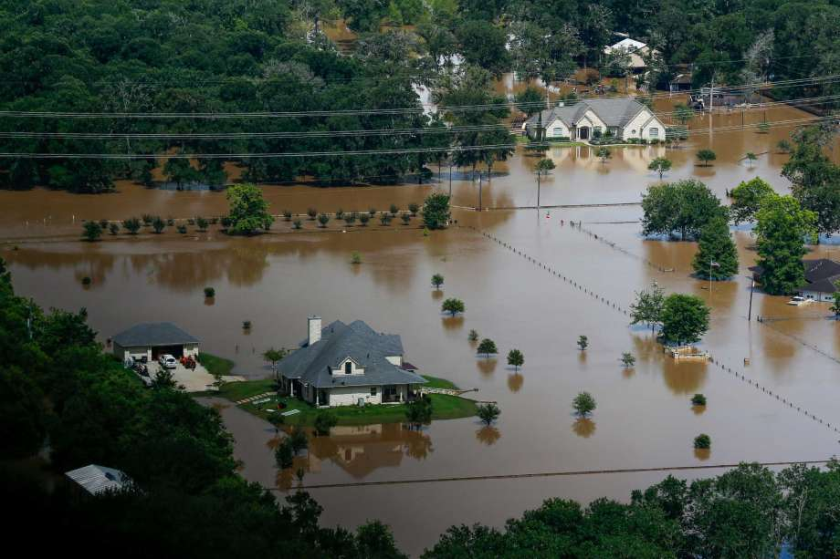
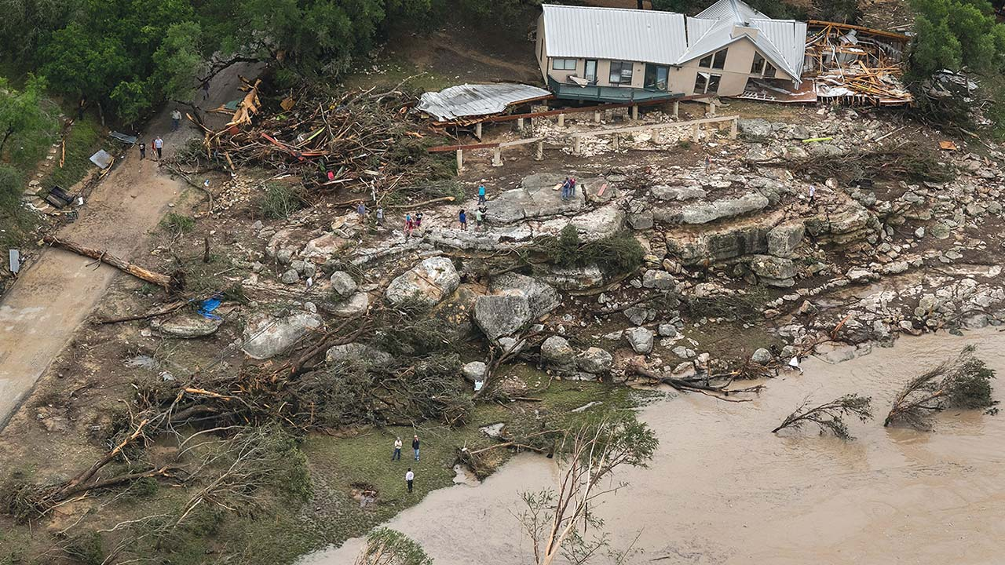
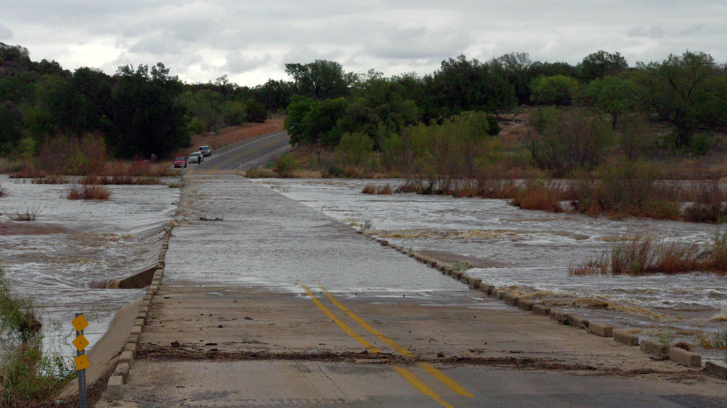
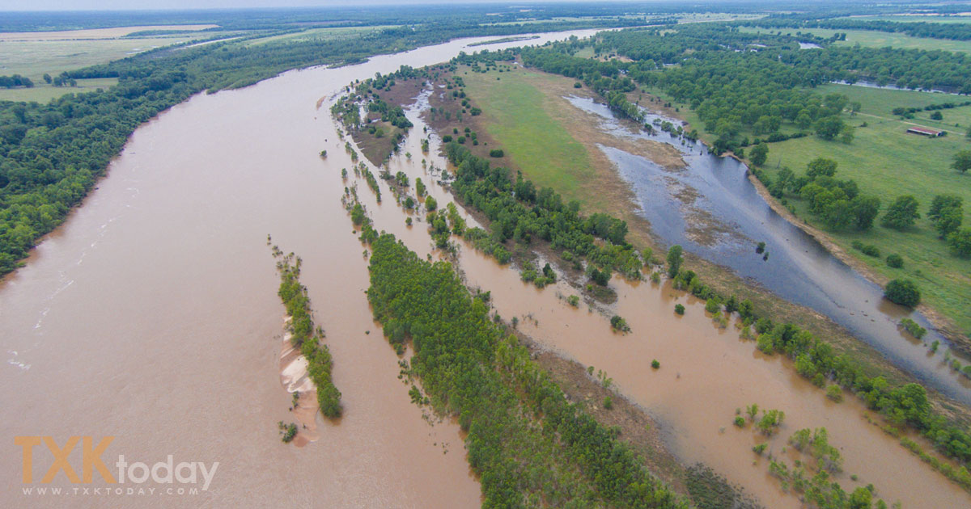
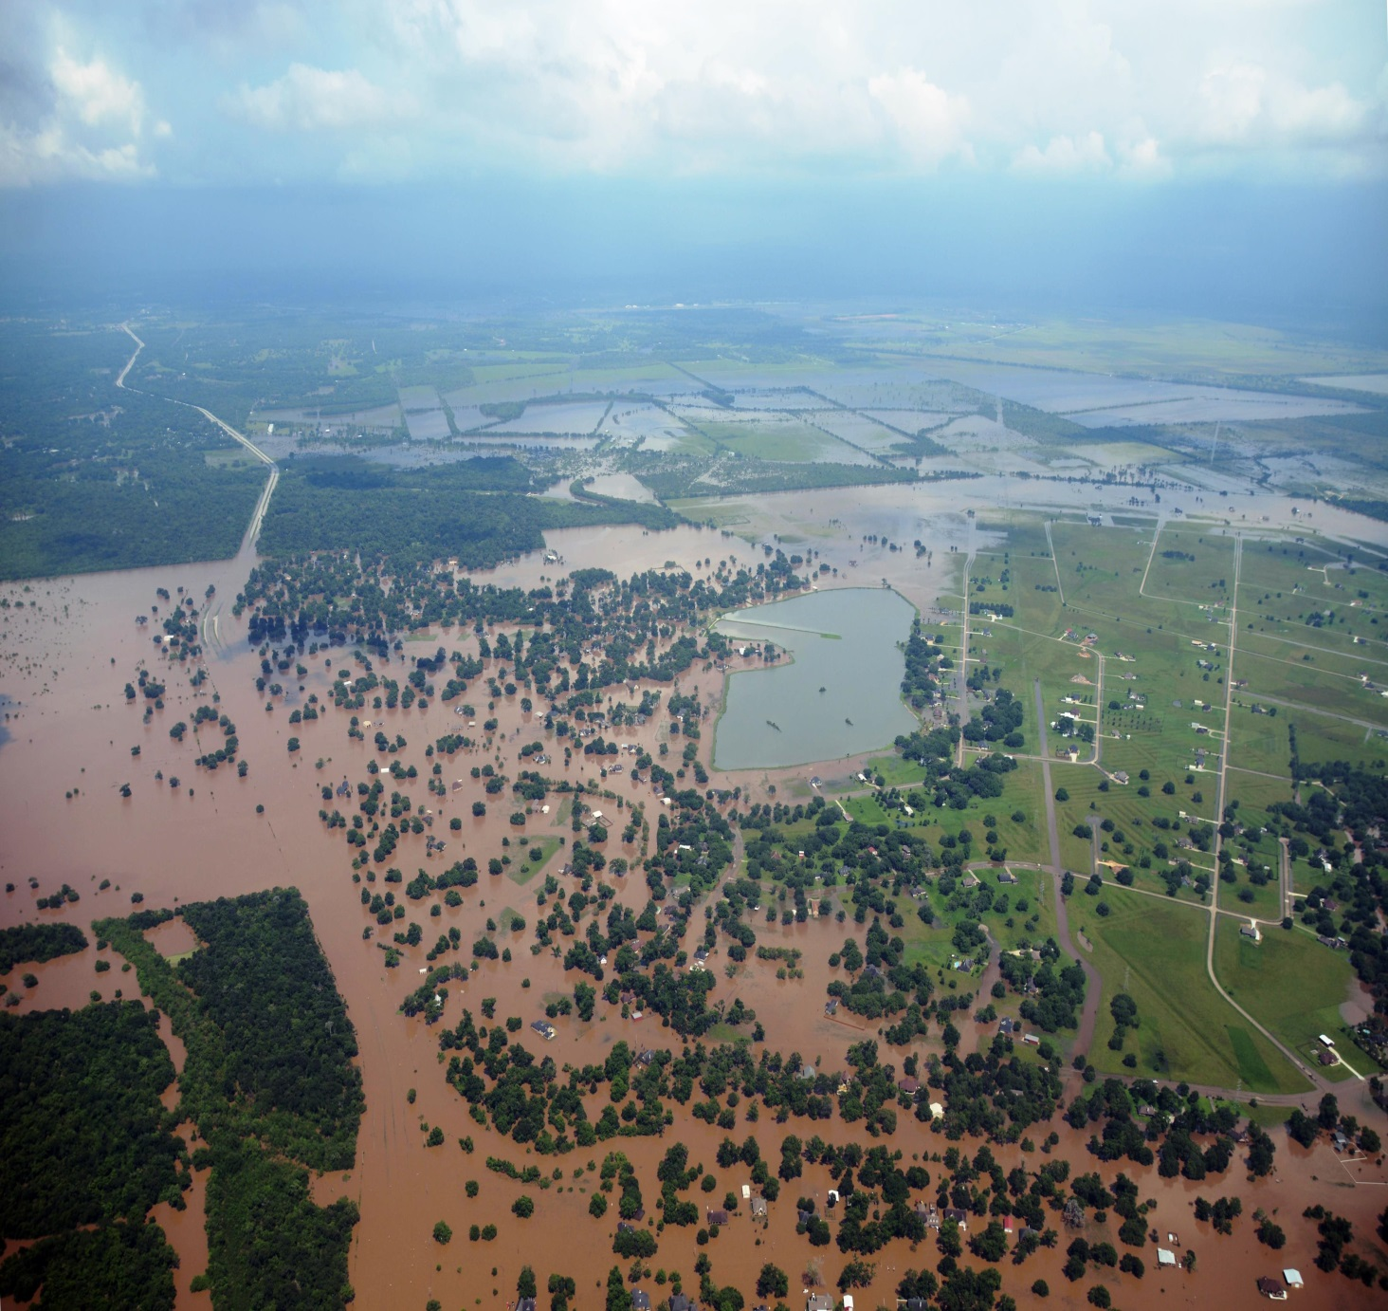
Understanding River Criteria Levels
BELOW CRITERIA
Impact: Water is within the banks of the river with no impacts to the surrounding area. Flow speeds may still be high during rainfall or releases which could impact recreational activities
ACTION
Impact: Water is over the banks and into the flood plain, but not a threat to structures or roadways. Some action may be required such as moving farm equipment or increasing awareness
MINOR
Impact: Typically water is impacting areas inside of flood plain which can vary by location. Some low water crossings covered by water, agricultural flooding, water approaching public areas (parks, sidewalks etc.). Areas frequently flooded can expect to be impacted
MODERATE
Impact: Water now reaching areas only impacted by significant rain events. Structures can be inundated, several roads covered with water, water may cut off certain areas, widespread agricultural flooding.
MAJOR
Impact: Water is near the highest its ever been representing rare flooding and significant widespread impacts. Most roads will be covered by water in the area cutting off if not completely flooding subdivisions, rivers can be several miles wide in areas. Homes and structures underwater, bridges inundated and in danger of being hit by debris. Impacts may be greater than ever experienced.

Slide 18
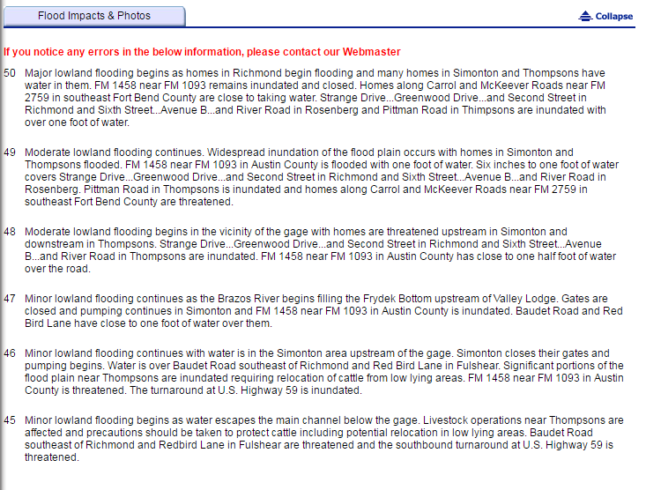
Impact Statements
Not tied directly to the flood criteria
Some are detailed while other may be more general
Do not cover all the local impacts, just an overview of those known impacts
Additional impacts that can be verified can and should be added

Slide 19
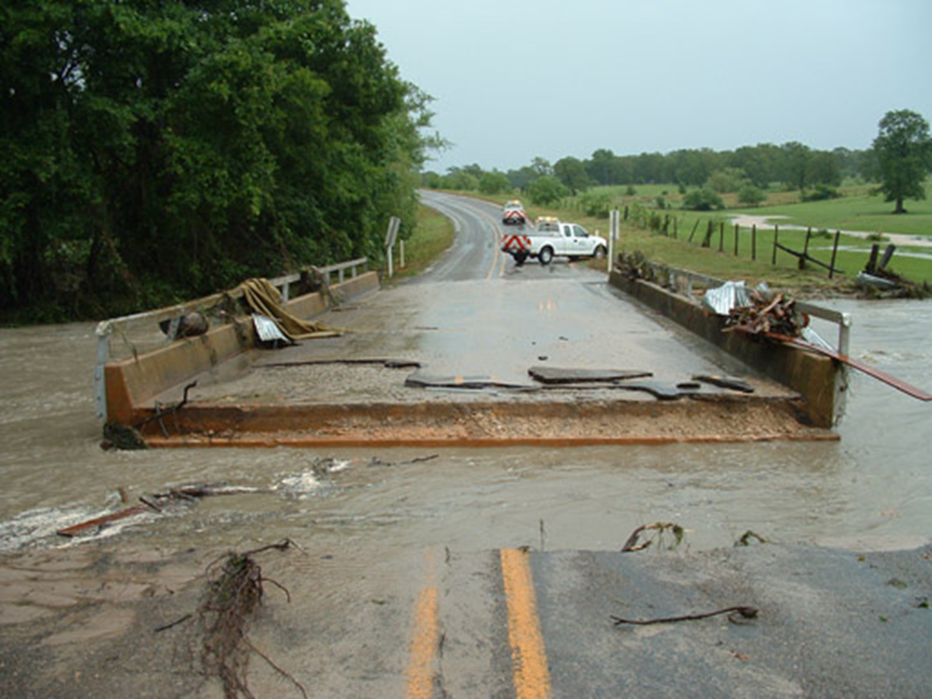
Flash Flood FSafety Tips
Turn Around, Don’t Drown
2-3 feet of water will float most vehicles
12 inches of fast-moving water can knock a person off balance
Stay away from creeks or ditches
Be especially cautious at night
Notes:
18

Slide 20
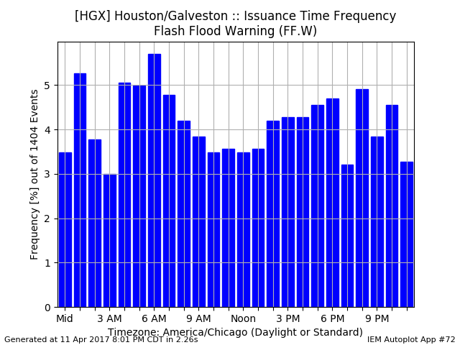
Flash Flood Safety

Slide 21
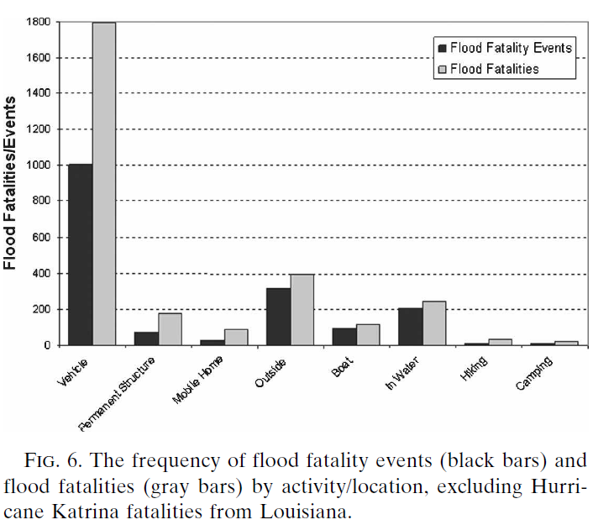
Fatality Frequency
From Ashley and Ashley, 2008;
50 years of data across the U.S.

Slide 22
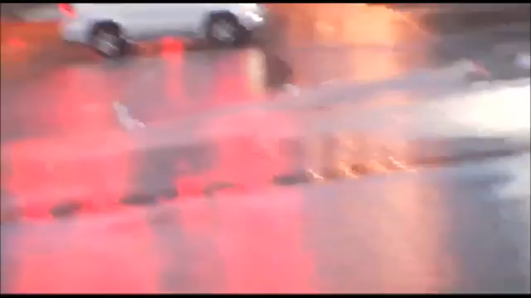
Houston Floods: April 18, 2016

Slide 23
Hurricanes

Slide 24
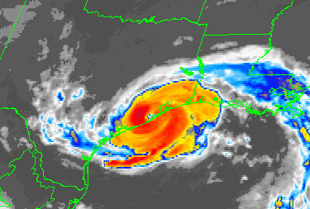
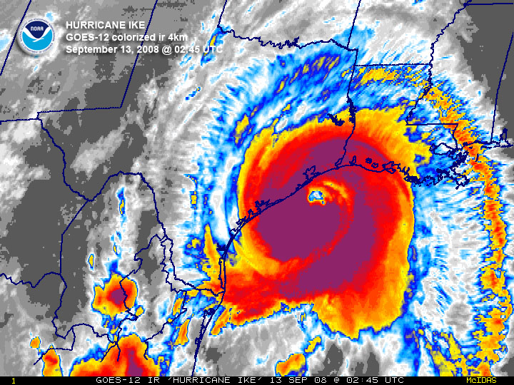
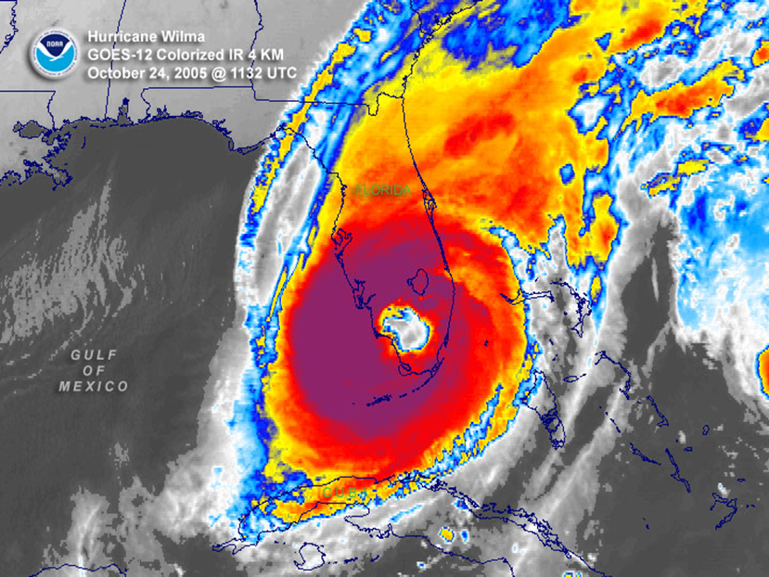
Hurricane Season Begins June 1
9 YEARS!
Hurricane Ike (2008)
last hurricane landfall in Southeast Texas.
12 YEARS!
Hurricane Wilma (2005) last major hurricane landfall in the U.S.
34 YEARS!
Hurricane Alicia (1983) last major hurricane landfall in Southeast Texas.

Slide 25
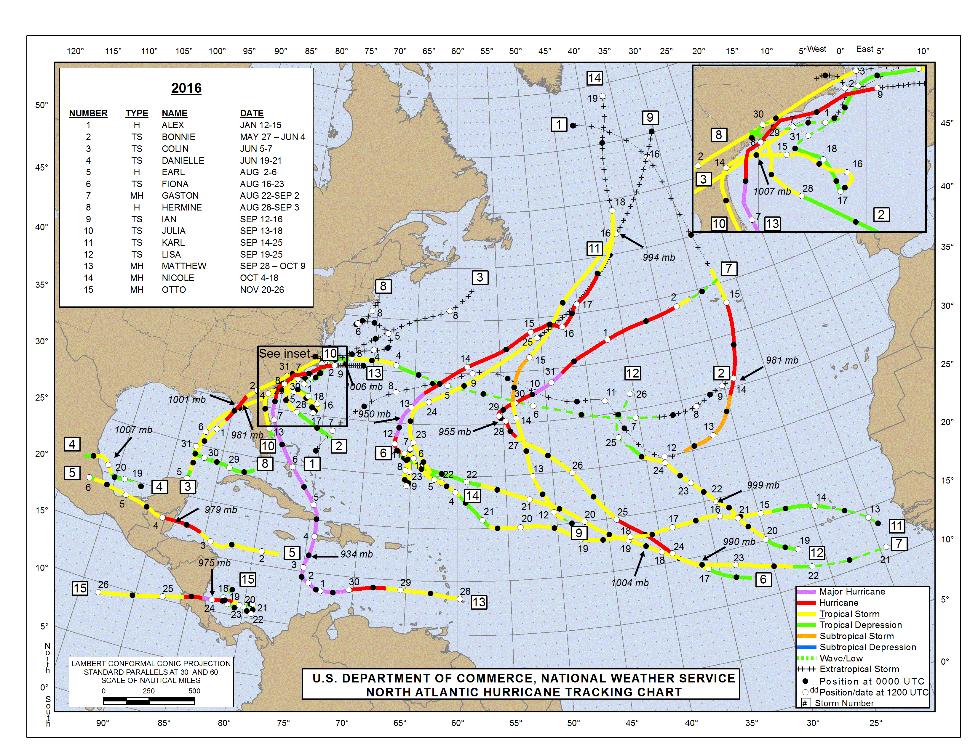
2016 Atlantic Season Summary
A close to normal year by just looking at the number of named storms

Slide 26
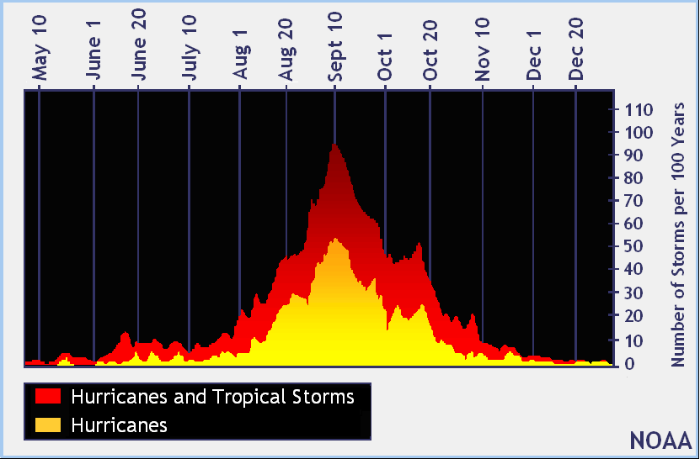
2017 Tropical Weather Outlook
Hurricane Season: June 1 - November 30
Historically, chances for Texas diminish in October after a few cold fronts have moved through the state
2017 Names
Arlene
Bret
Cindy
Don
Emily
Franklin
Gert
Harvey
Irma
Jose
Katia
Lee
Maria
Nate
Ophelia
Philippe
Rina
Sean
Tammy
Vince
Whitney

Slide 27
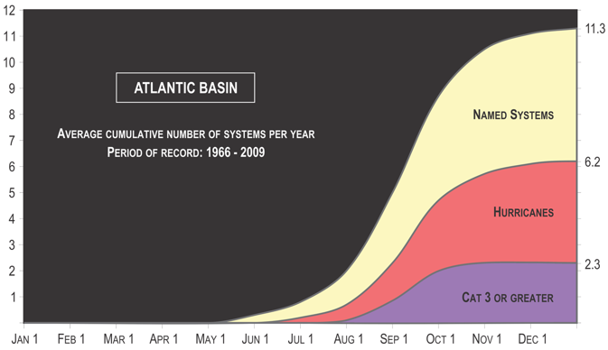
2017 Tropical Weather Outlook
In an “average” hurricane season…
  11 named tropical storms (39-73 MPH)
    6 of which strengthen to hurricanes (74+ MPH)
      2 of which further strengthen to major hurricanes: category 3-5 (111+ MPH)

Slide 28
CSU 2017 Forecast (April 6, 2017)
Forecast Parameter | Final Forecast | 1981-2010 Median
Named Storms (NS) | 11 | 12.0
Hurricanes (H) | 4 | 6.5
Major Hurricanes (MH) | 2 | 2.0
Notes:
NOAA forecast will be released Friday, May 27

Slide 29
2017 Tropical Weather Outlook
NOAA releases their 2017 outlook in late May
Consensus is for a near or slightly below normal season overall in the Atlantic
  No information about tropical activity in the Gulf or Texas landfalls
Need to be prepared every year for a possible landfall
Bottom line: the number of forecast storms doesn’t matter
  It only takes one for a bad year!

Slide 30
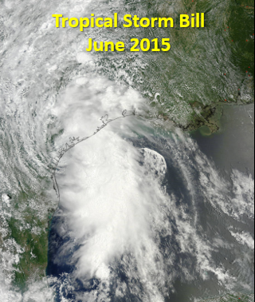
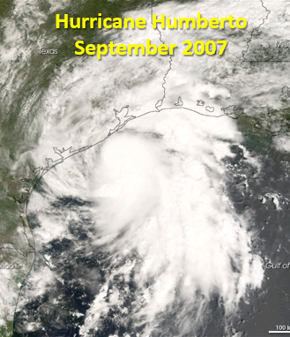
Storms Can Develop Quickly Near the Coast
Are you prepared to implement your plan quickly with minimal lead time?
You may need to make important decisions based on a forecast before watches or warnings are issued
Notes:
TS Bill: Because Bill formed so close to land, tropical storm force winds first reach the coast within 12 hours of issuance of the initial Tropical Storm Warning
Hurricane Humberto: Humberto strengthened from a 30 MPH low into a 90 MPH hurricane within 24 hours along the Upper Texas coast

Slide 31
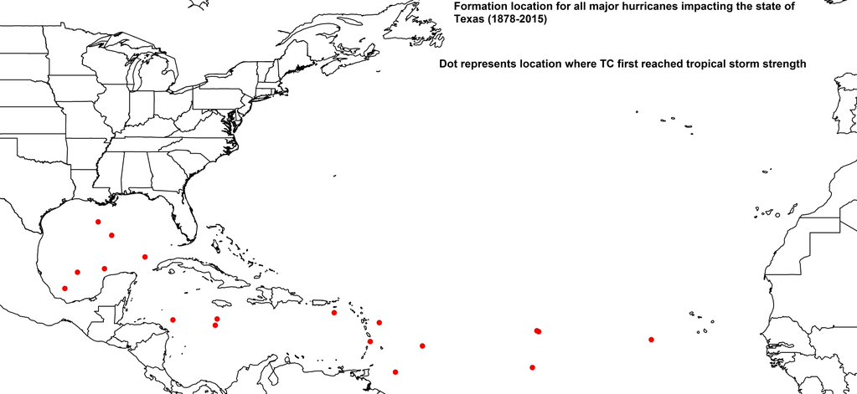
Major Hurricane Formation (1878-2015)
6 of the 18 major hurricanes to affect Texas have formed in the Gulf.
Might not have that much time to prepare – think about your hurricane plan today.
Graphic from Klotzbach

Slide 32
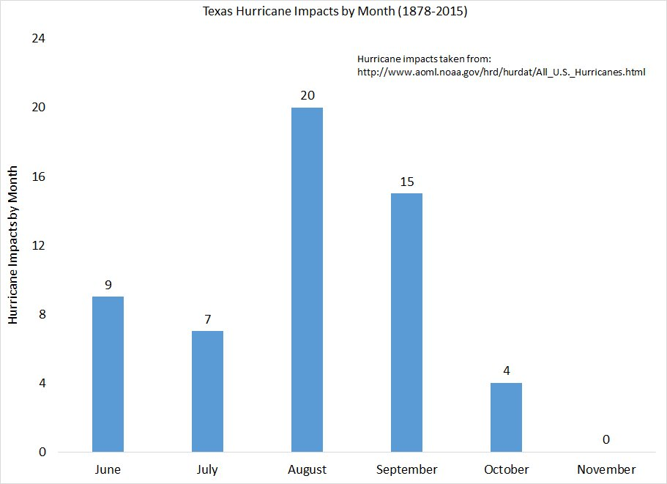
Texas Hurricane Impacts by Month
From Klotzbach
More in June & July than in September
August the peak
  Think about the heat after an August hurricane with no power
None in November

Slide 33
Saffir-Simpson Hurricane Wind Scale
Category | Sustained Winds (mph) | Storm Examples | Wind Impacts
1 | 74 - 95 | Jerry 1989 Humberto 2007 | Very dangerous; will produce some damage
2 | 96 - 110 | Georges 1998 Ike 2008 | Extremely dangerous; will produce extensive damage
3 | 111 - 129 | Alicia 1983 | Devastating damage
 |  | Katrina 2005
4 | 130 - 156 | 1900 Galveston | Catastrophic damage
 |  | Carla 1961
5 | 157 or greater | Andrew 1992 | Catastrophic damage
The scale estimates potential property damage from wind

Slide 34
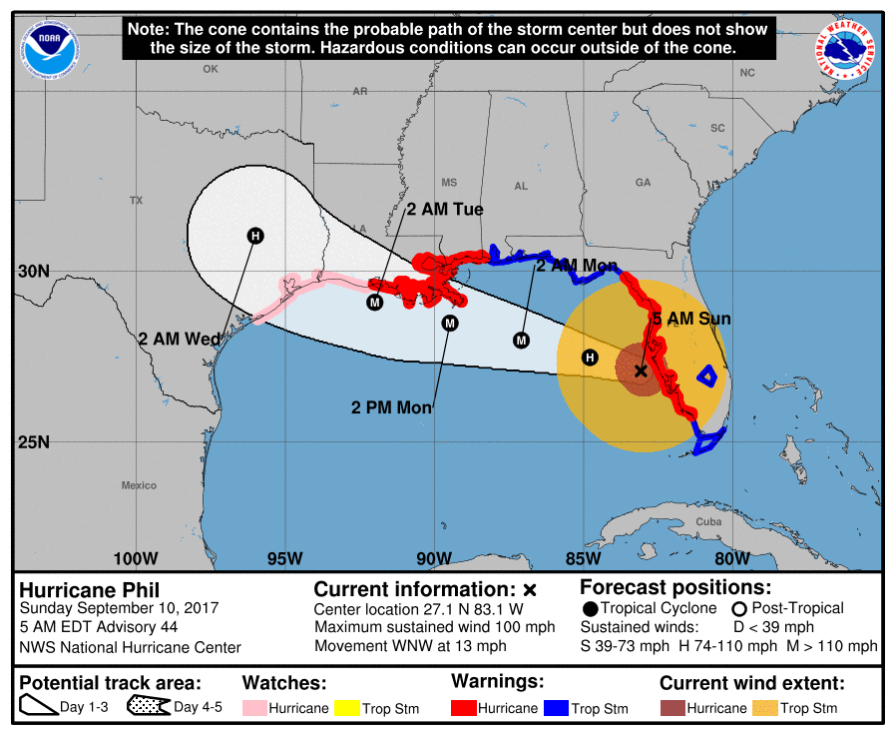
Understanding Tropical Forecasts
Forecast Cone
Forecast Positions (for storm center)
Current Wind Extent
Current Tropical Storm or Hurricane Watches & Warnings
www.hurricanes.gov

Slide 35
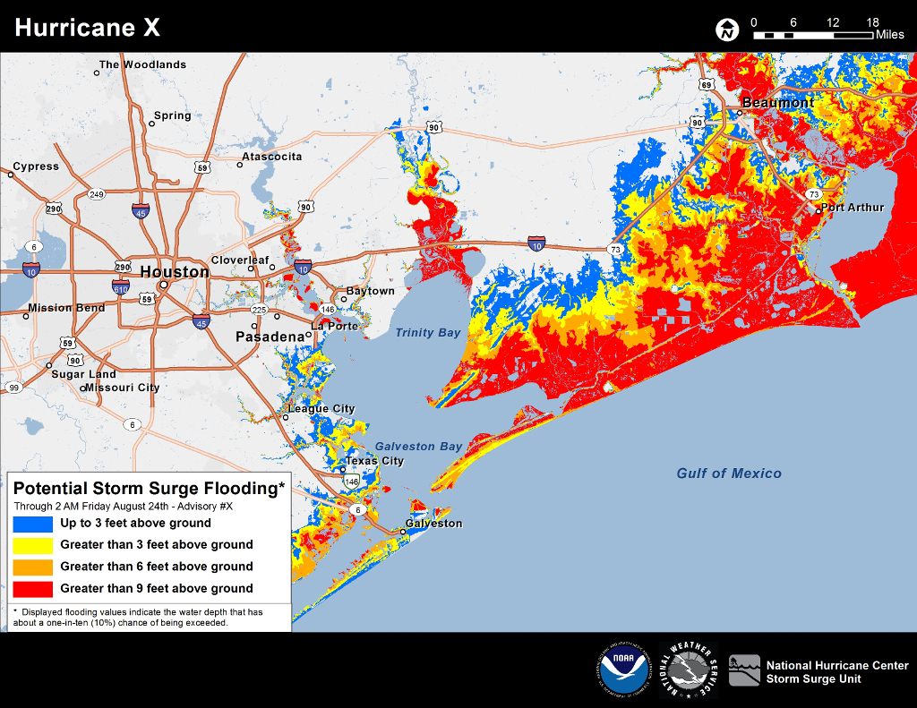
New Since Ike: Potential Inundation
Potential Storm Surge Flooding Graphic
Think of it as Reasonable Worst Case Surge Flooding Above Ground Level
http://www.nhc.noaa.gov/experimental/inundation/

Slide 36

New Since Ike: Storm Surge Watch/Warning
Issued for areas that may experience life-threatening flooding from storm surge 36-48 hours before landfall of a tropical cyclone
Note: This will not appear on the forecast cone graphic!

Slide 37
Flood & Hurricane Preparedness
Melissa Huffman, Meteorologist
National Weather Service – Houston/Galveston, TX
weather.gov/houston
melissa.huffman@noaa.gov
(281) 337-5074

