Slide 1
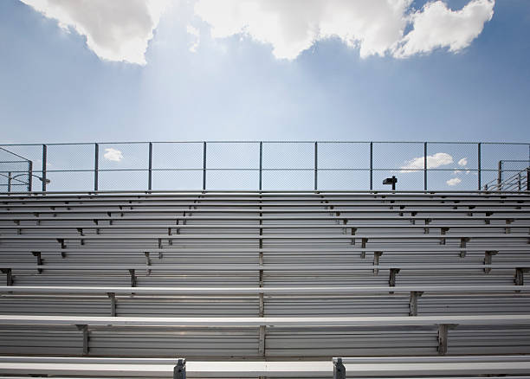
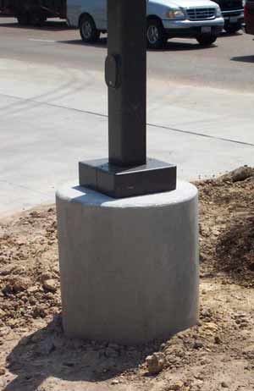

Maintenance of Bleachers and Light Poles
Texas Gulf Coast Maintenance and Operations Meeting
January 11, 2018
Joanna Monge, P.E.
Senior Project Engineer

Slide 2

What do we want to know?
Who?
What?
When?
Where?
Why?
How?
What?
Why?
When?
Who?
How?
Where?

Slide 3
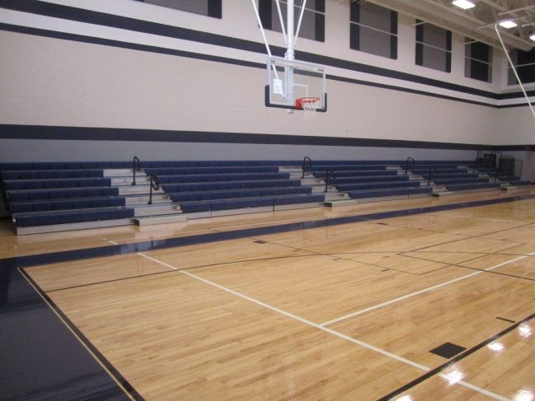
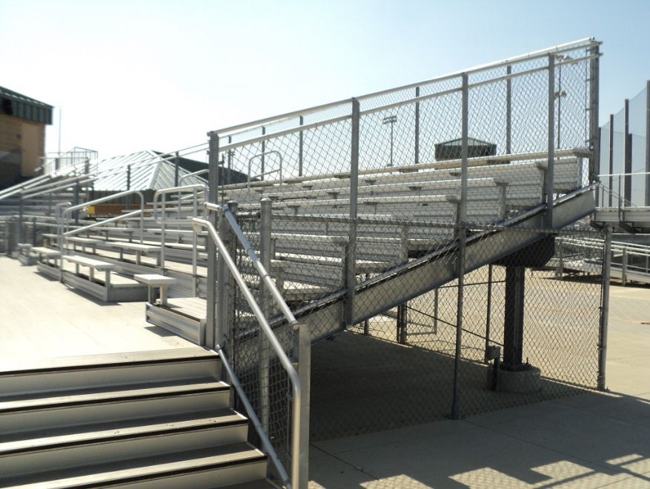
What?
Bleachers
Interior, telescopic
Exterior, grandstand
Portable, free standing
Aluminum
Steel
Wood

Slide 4
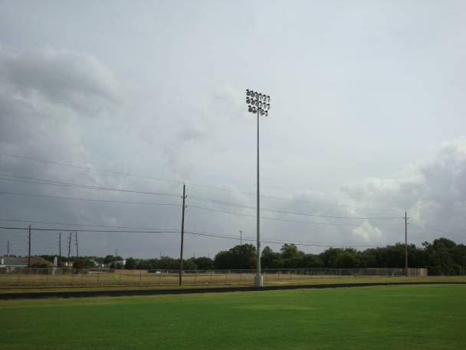
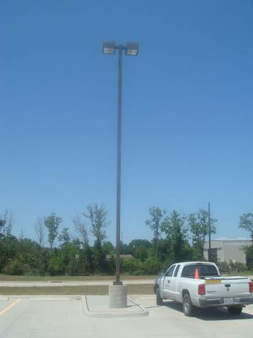
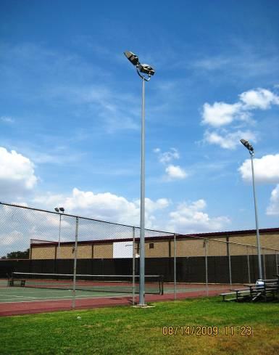
What?
Light Poles
Parking Lots
Stadium/Athletic/High Mast/Monopole

Slide 5
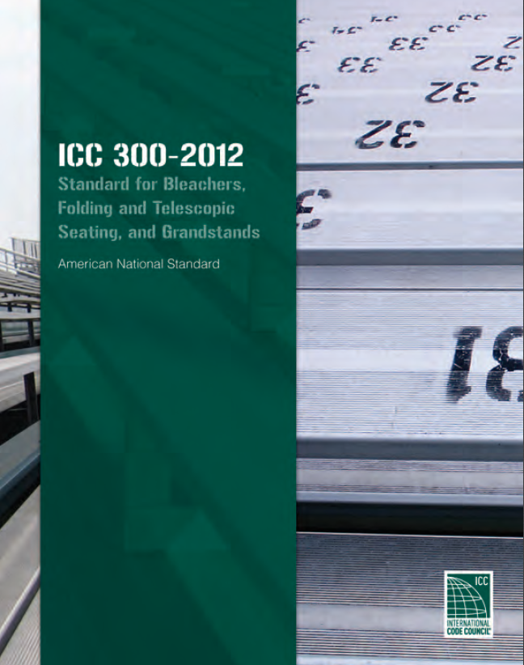

What?
Applicable Standards
ICC 300: Standard for Bleachers, Folding, and Telescopic Seating, and Grandstands
AASHTO LTS-5: Standard Specifications for Structural Supports for Highway Signs, Luminaires, and Traffic Signals
ICC – International Code Council
AASHTO – American Association of State Highway and Transportation

Slide 6
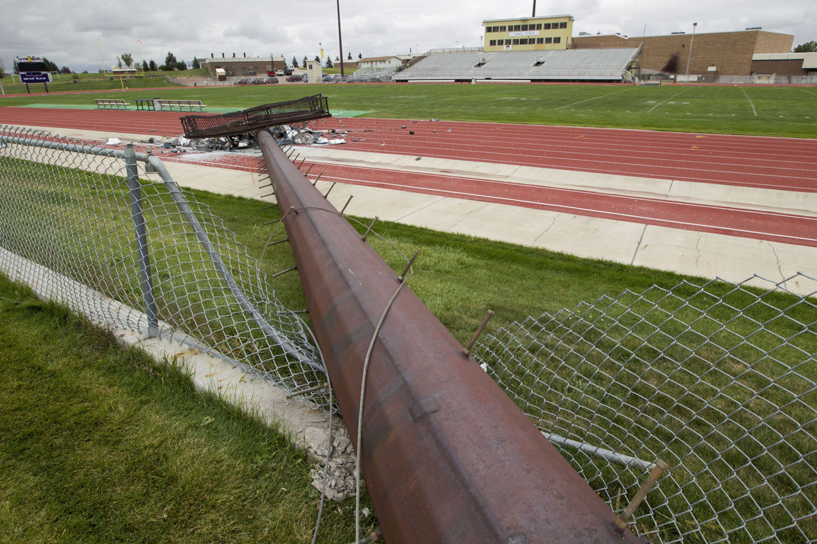
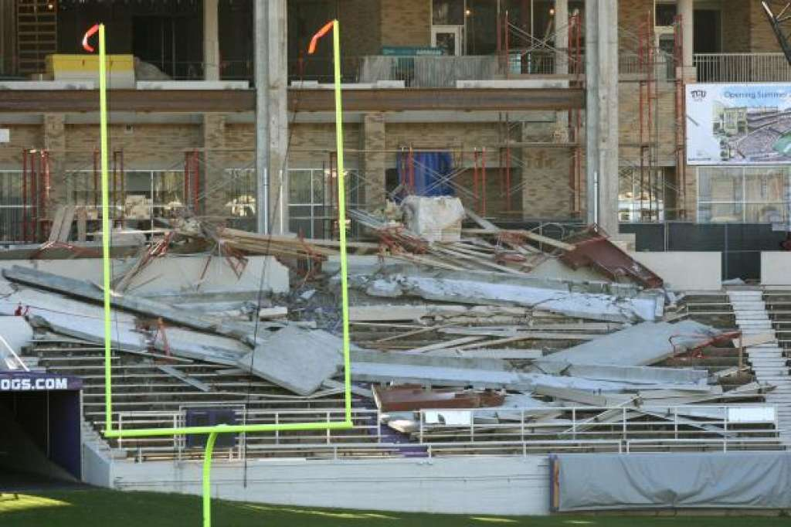
Why?
  Safety
  “An ounce of prevention is better than a pound of cure.”
  Properly designed and maintained bleachers and light poles will remain in service for a long time
  Cost savings

Slide 7
New Bleachers and Light Poles
Engage licensed professional engineers and architects
Designs are signed and sealed by professional engineers
In accordance with:
  ICC 300: Standard for Bleachers, Folding, and Telescopic Seating, and Grandstands
  AASHTO LTS-5: Standard Specifications for Structural Supports for Highway Signs, Luminaires, and Traffic Signals

Slide 8
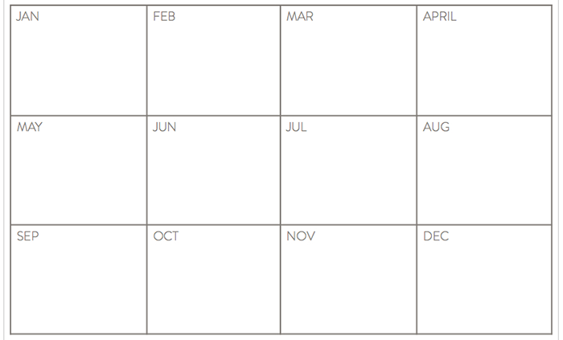
When?
YEAR
Quarter
Quarter
Bleachers
  ICC 300 – annual
  Quarterly by maintenance team
  Biannually by third-party inspectors
Light Poles
  AASHTO LTS-5 – annual
  Quarterly by maintenance team
  Biannually by third-party inspectors
Day-to-day
Biannual
Quarter
Quarter
Biannual

Slide 9

Who?
Maintenance personnel
Manufacturer’s warranty
Third-party material testing and inspection companies
  Licensed/qualified personnel (engineers, architects) with bleachers and light pole engineering experience
  AWS certified welding inspectors for non-destructive testing

Slide 10
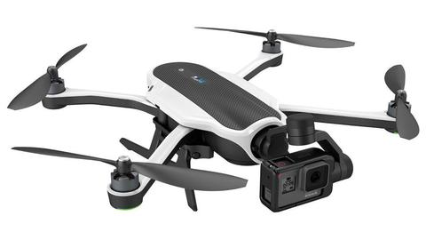

How?
Visual assessment
  Aerial working platforms
  Drone cameras
  Borescope
Non-destructive testing
  Coating thickness test (galvanized/peeling paint)
  Magnetic particle testing for cracks in welds
  Ultrasonic thickness testing for material section/thickness loss due to corrosion

Slide 11
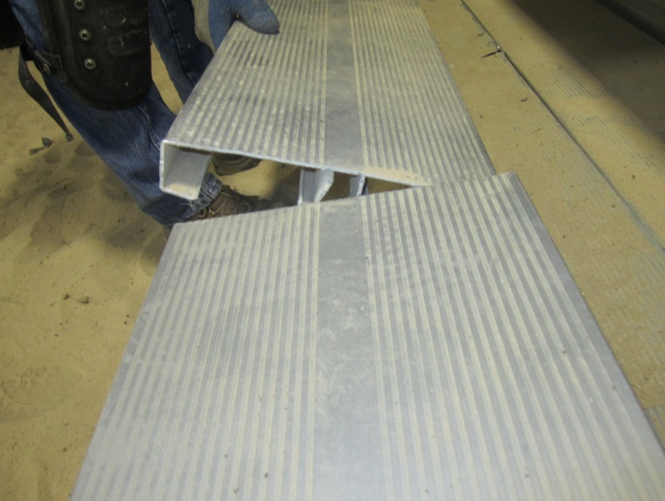
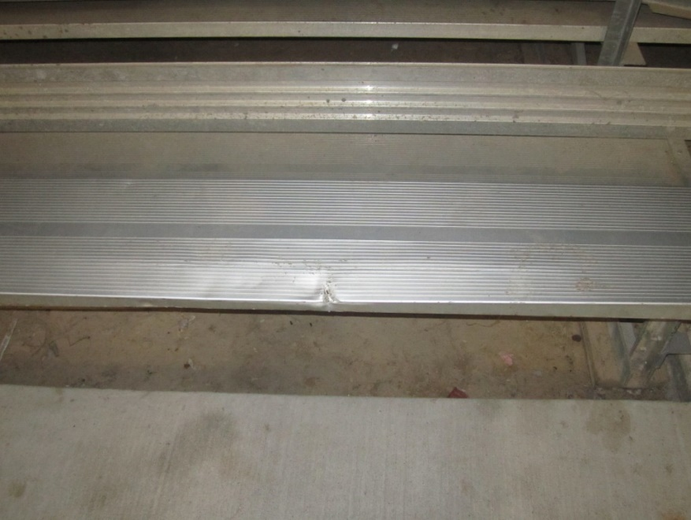
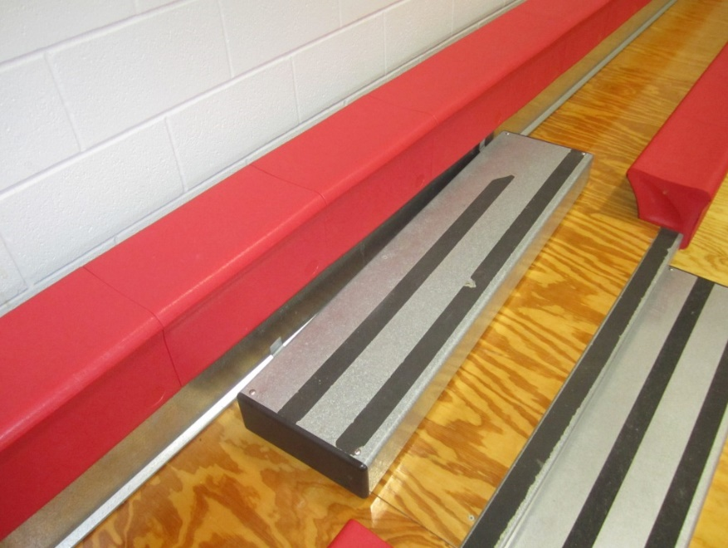
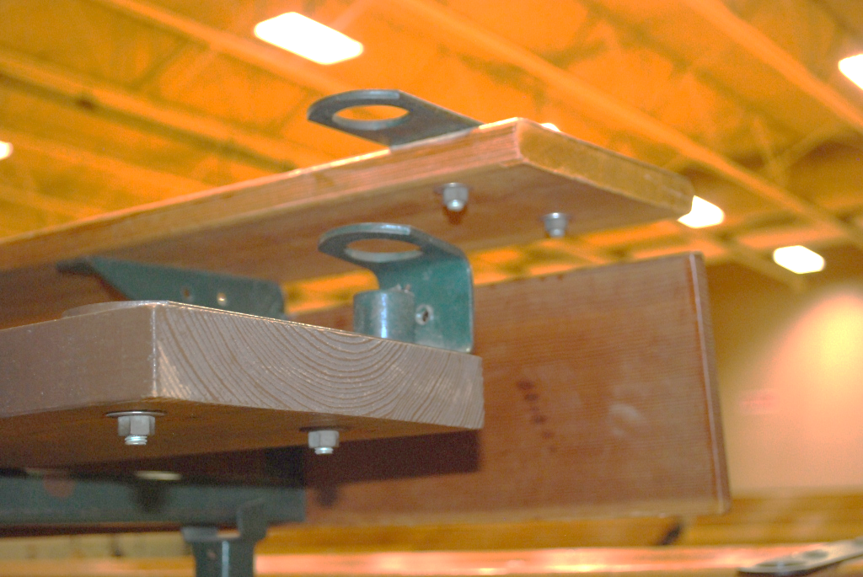
Where? Bleachers – Seating and Steps

Slide 12
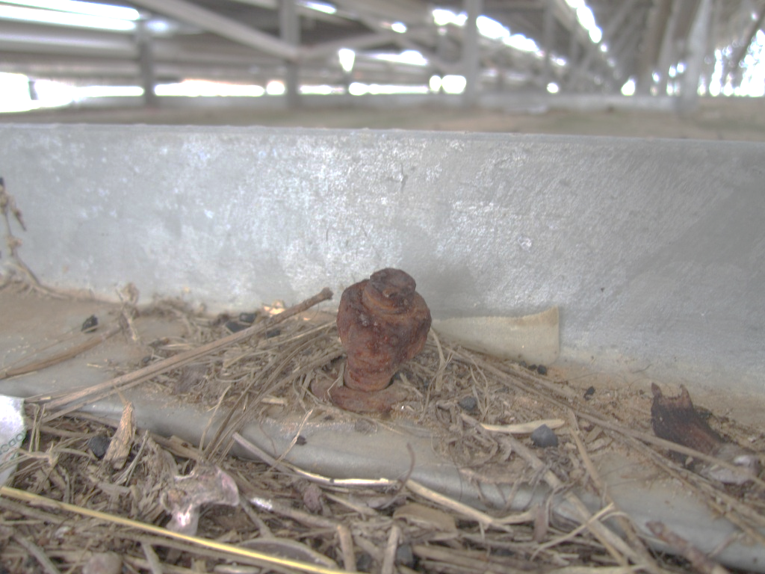
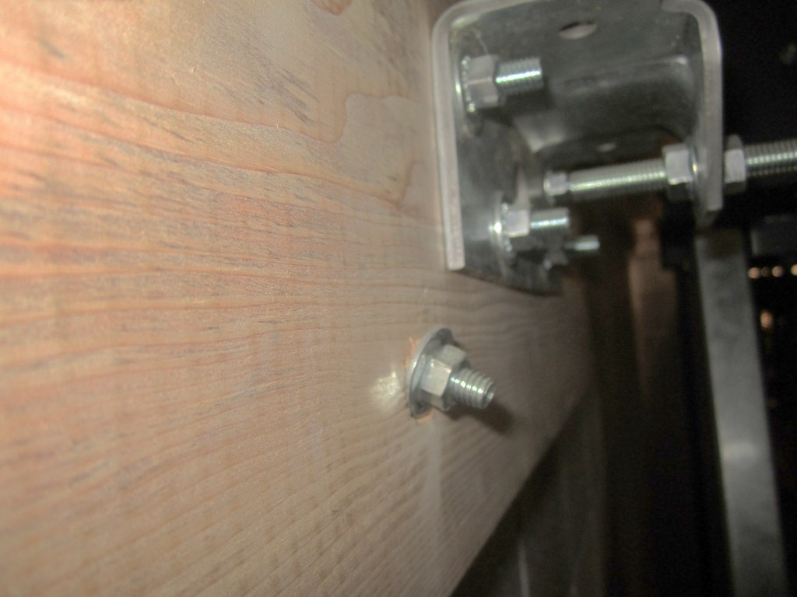
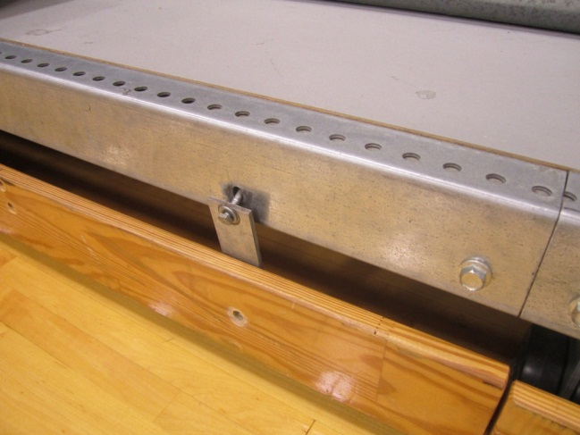
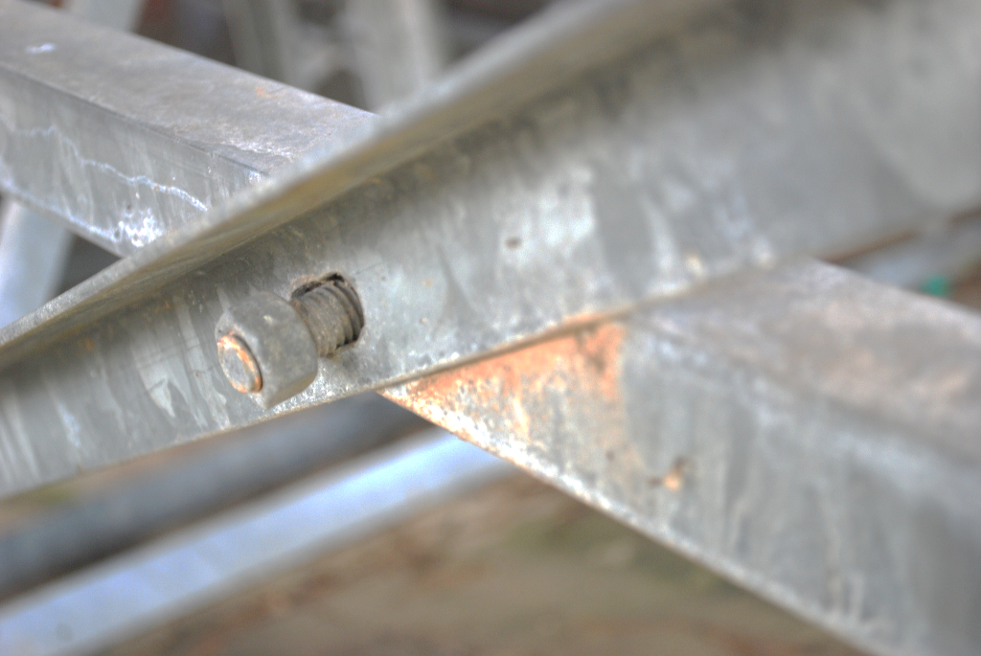
Where? Bleachers – Connections and Fasteners

Slide 13
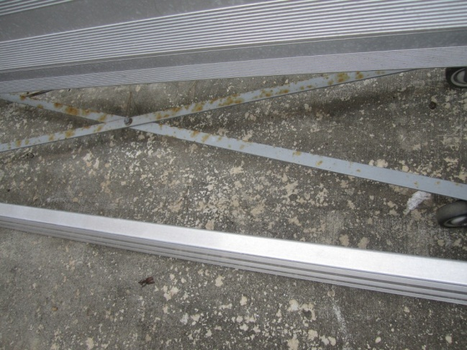
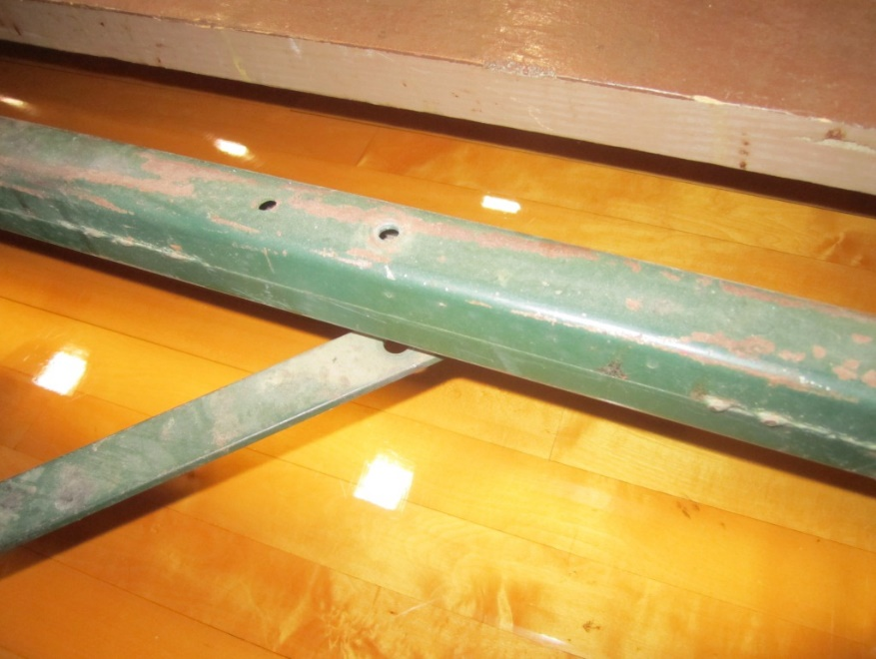
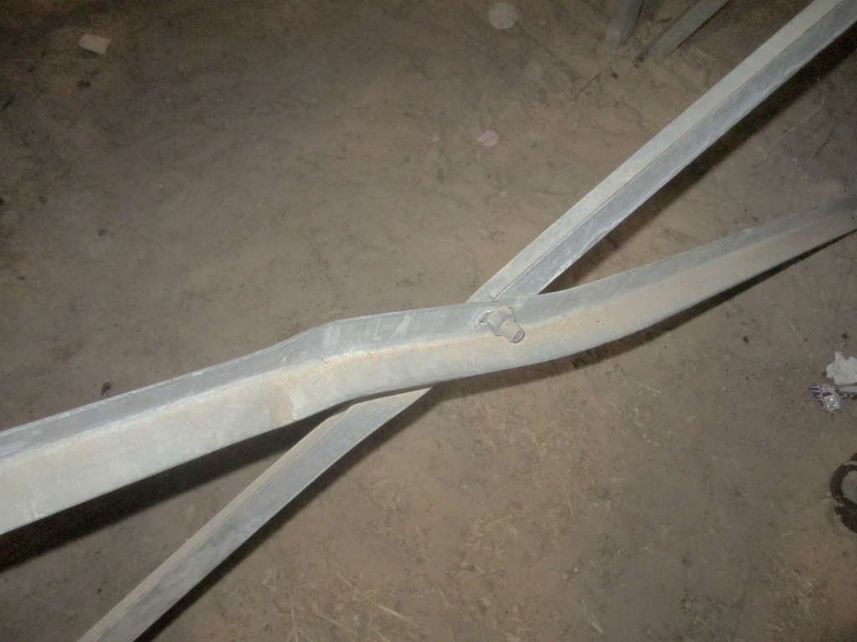
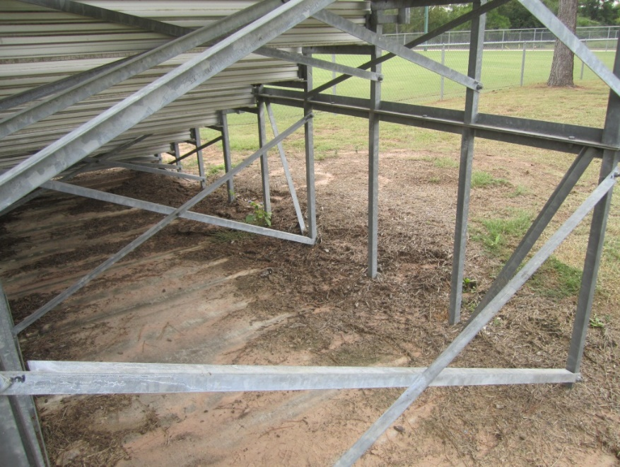
Where? Bleachers – Lateral stabilizing elements

Slide 14
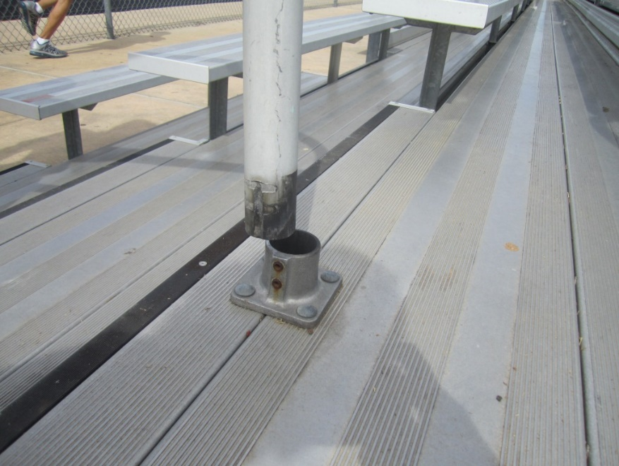
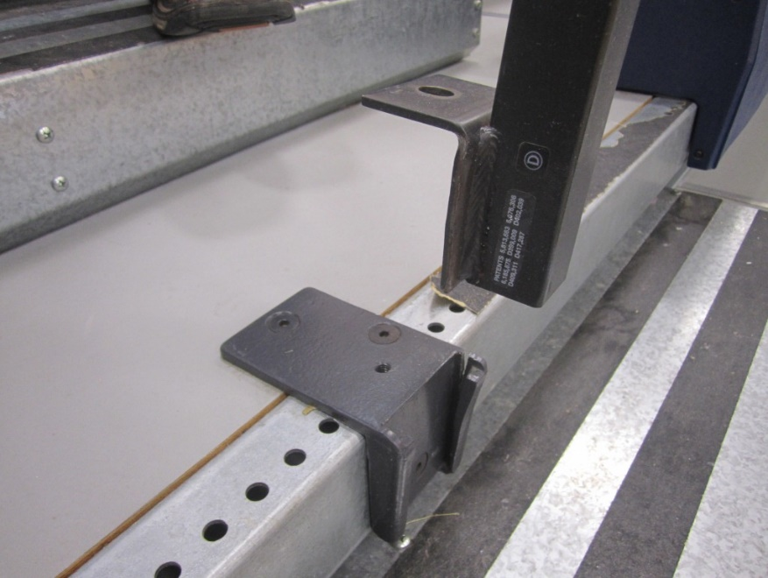
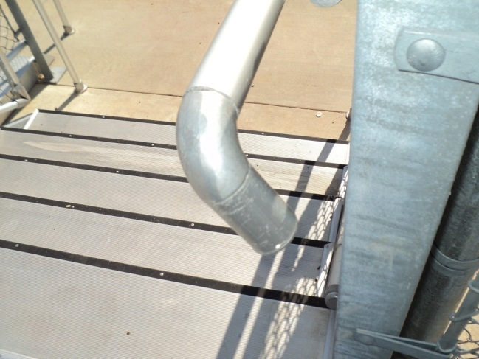
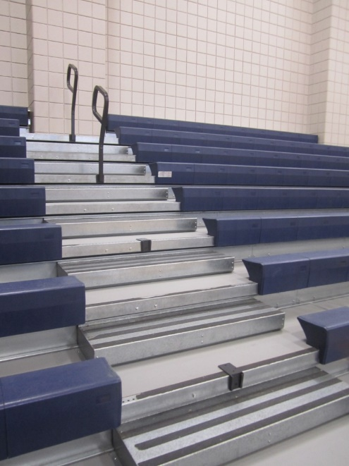
Where? Bleachers – Handrails

Slide 15
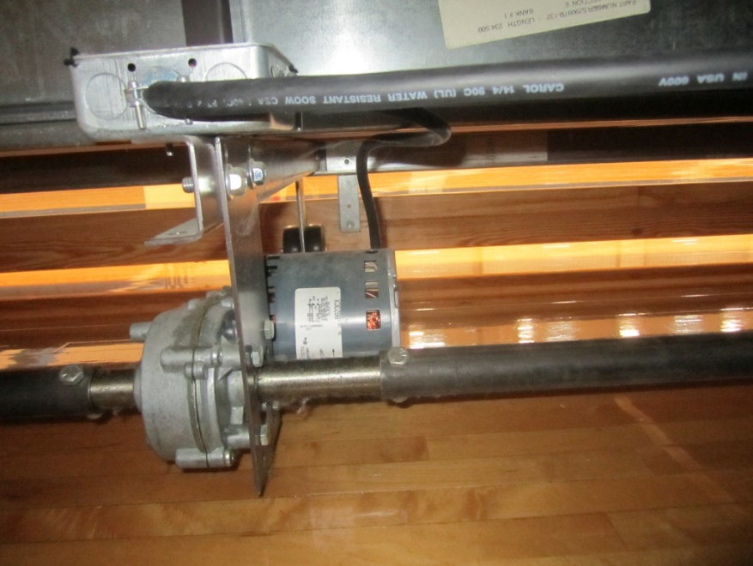
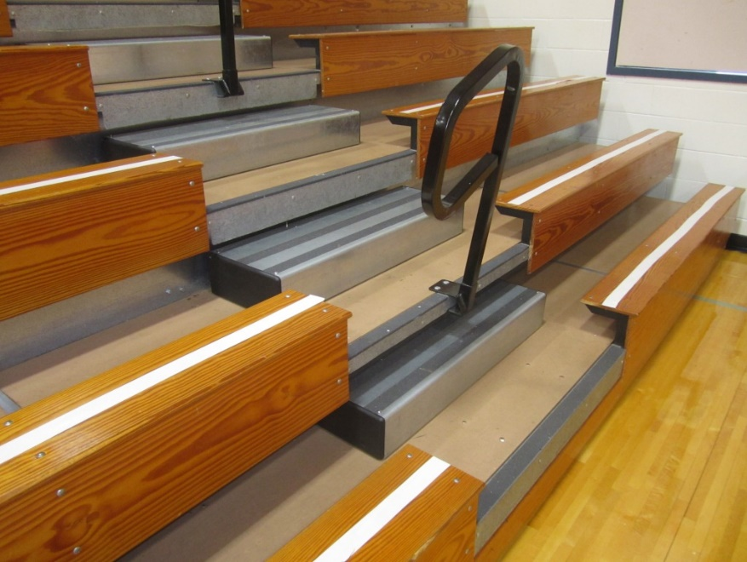
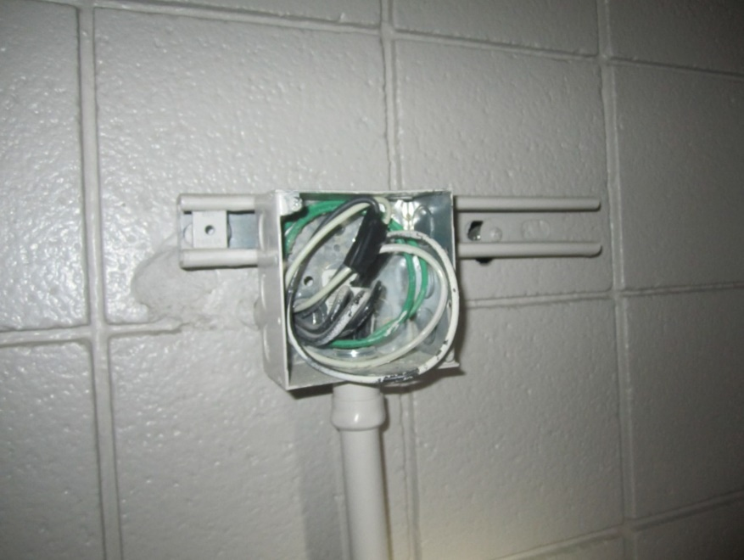
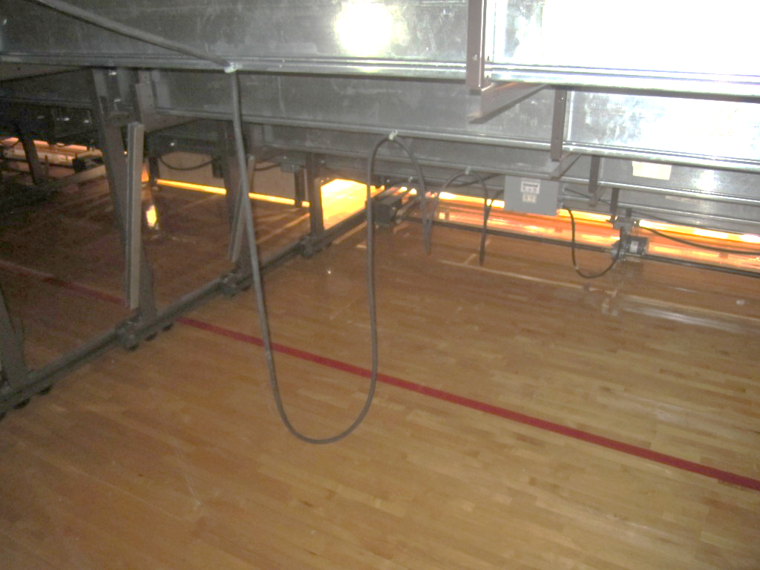
Where? Bleachers – Mechanisms

Slide 16
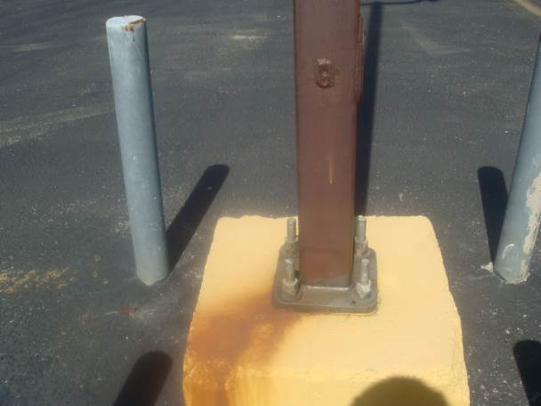
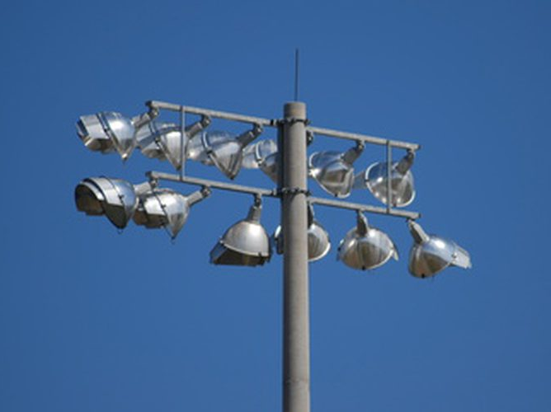
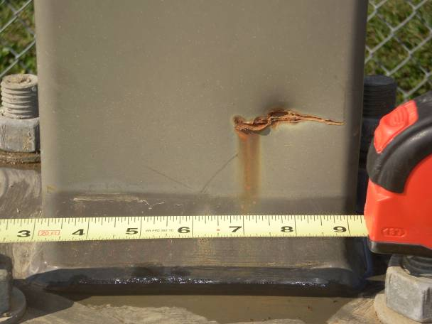
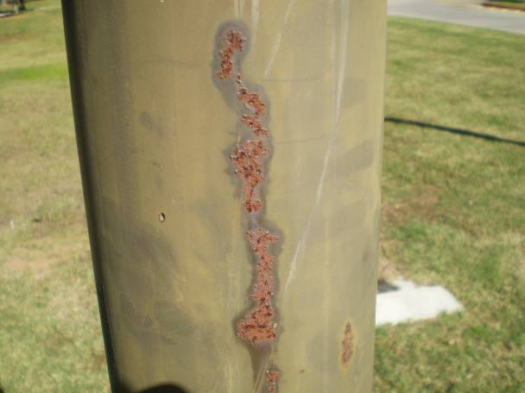
Where? Light Poles – Pole Shaft and Fixtures

Slide 17
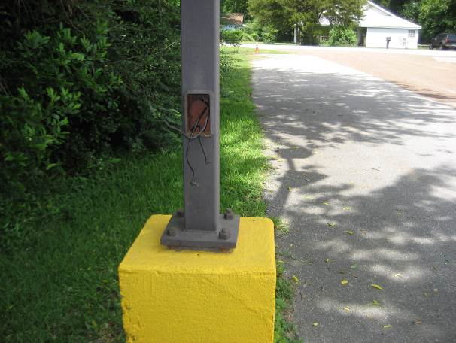
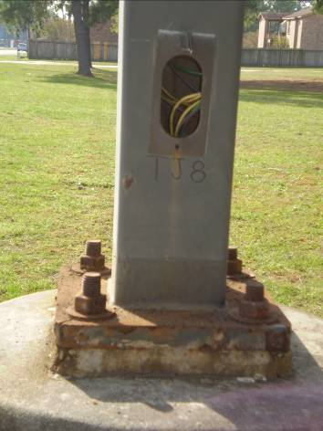
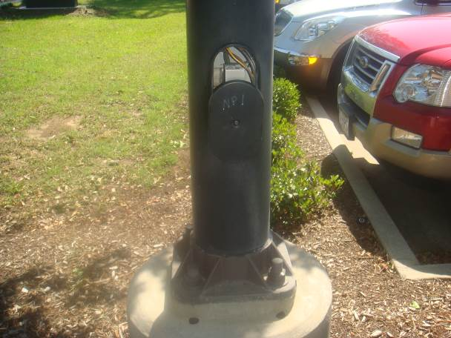
Where? Light Poles – Handholes

Slide 18
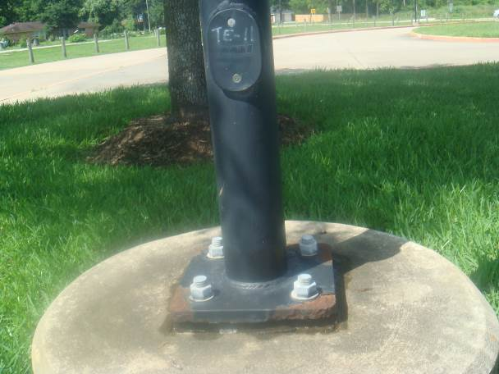
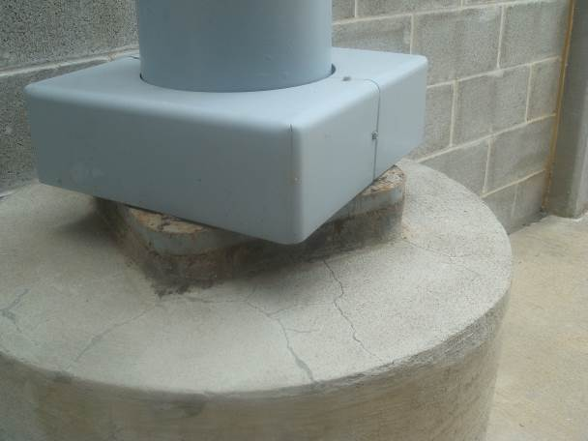
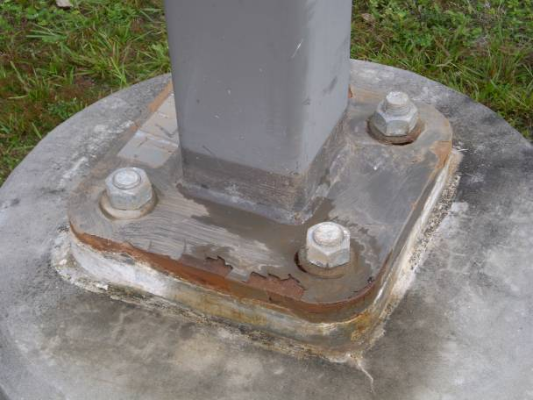
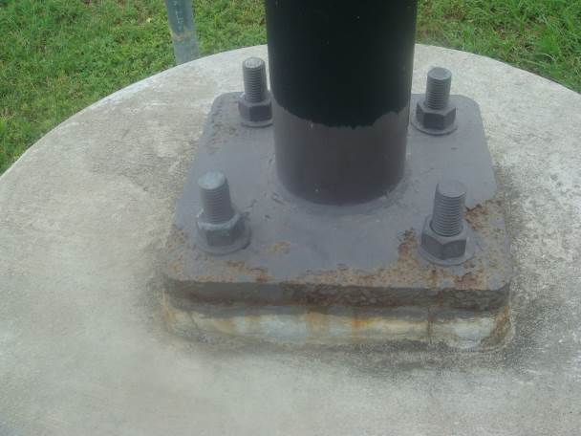
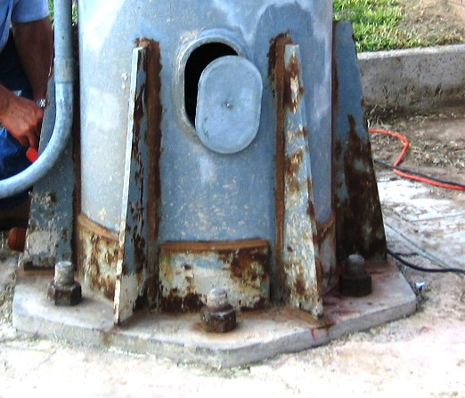
Where? Light Poles – Base Plates and Covers

Slide 19
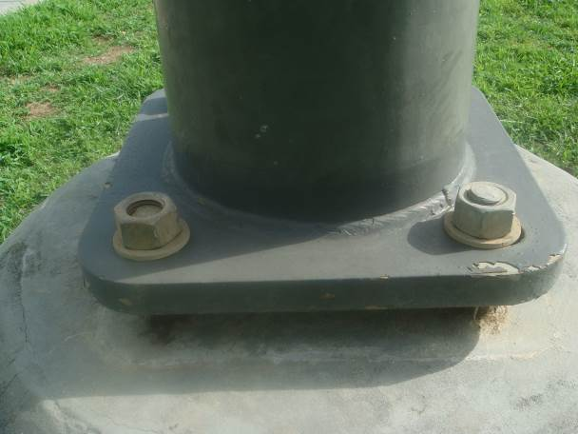
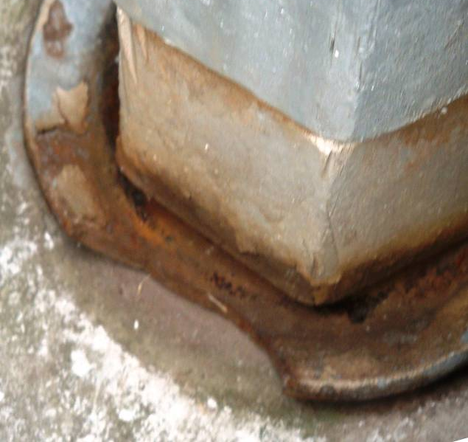
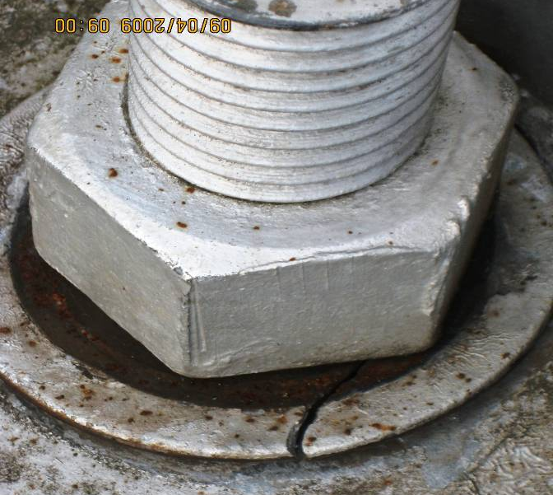
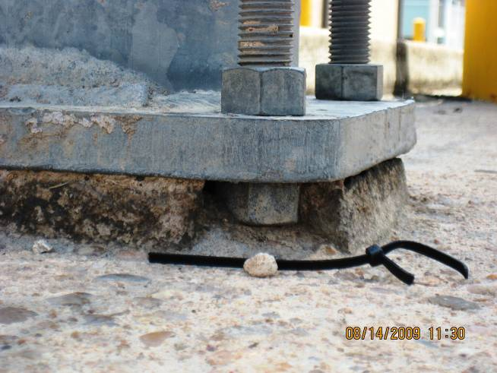
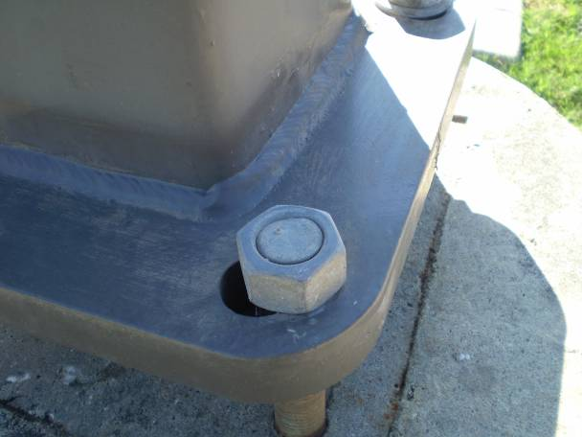
Where? Light Poles – Anchor Bolts and Fasteners

Slide 20
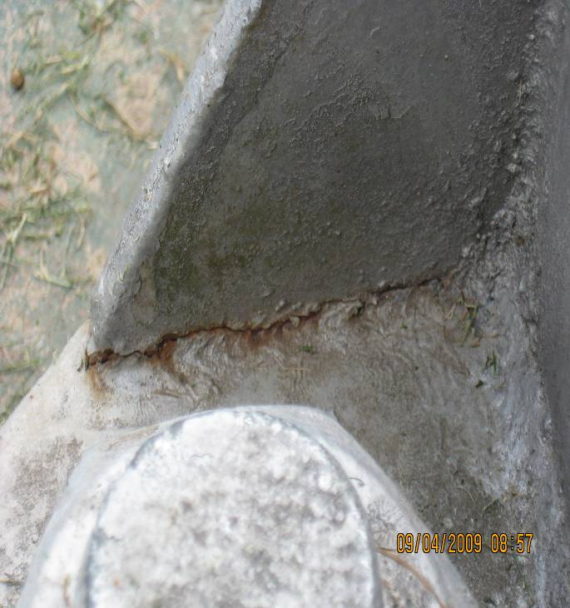


Where? Light Poles – Welds

Slide 21


Data Asset Management – Out with the Old
What do you do with the information?
  Field evaluation forms
  Photos
Transfer data to:
  Spreadsheets
  Photo Logs
  Cross-referencing
Tedious and time-consuming
  Maintain archive records
  Growing paperwork

Slide 22

Data Asset Management – In with the New
Terracon’s updated approach
Online cloud storage-based data management system
  Aerial maps (Bing, Google, Eagleview, etc.)
  Tag facilities and assets
  Access via mobile app or desktop
  GPS coordinates
  Real-time updates

Slide 23




Data Asset Management – Mobile Data Input

Slide 24

Data Asset Management – District View (Desktop)

Slide 25

Data Asset Management – Facility View (Desktop)

Slide 26

Data Asset Management – Asset Window (Desktop)

Slide 27
Data Asset Management – Online Data Export (Inventory)
Facility Name | General Location | Asset Identifier | Bleacher Type | Frame/Structural Material Type | Frame/Structural Coating System | Number of Rows | Seating Material Type | Tread Area Material Type | Tread Area Coating (if applicable) | Seating Area Coating (if applicable)
HS | FOOTBALL | FOOTBALL-B-1 | FIX | STEEL | GALV | 33 | AL | AL | ANO | MILL
HS | FOOTBALL | FOOTBALL-B-2 | FIX | STEEL | GALV | 33 | AL | AL | ANO | MILL
HS | FOOTBALL | FOOTBALL-B-3 | FIX | STEEL | GALV | 33 | AL | AL | ANO | MILL
HS | FOOTBALL | FOOTBALL-B-4 | FIX | STEEL | GALV | 33 | AL | AL | ANO | MILL
HS | FOOTBALL | FOOTBALL-B-5 | FIX | STEEL | GALV | 33 | AL | AL | ANO | MILL
HS | FOOTBALL | FOOTBALL-B-6 | FIX | STEEL | GALV | 18 | AL | AL | ANO | MILL
HS | FOOTBALL | FOOTBALL-B-7 | FIX | STEEL | GALV | 18 | AL | AL | ANO | MILL
HS | FOOTBALL | FOOTBALL-B-8 | FIX | STEEL | GALV | 18 | AL | AL | ANO | MILL
HS | FOOTBALL | FOOTBALL-B-9 | FIX | STEEL | GALV | 18 | AL | AL | ANO | MILL
HS | FOOTBALL | FOOTBALL-B-10 | FIX | STEEL | GALV | 30 | AL | AL | ANO | MILL
HS | FOOTBALL | FOOTBALL-B-11 | FIX | STEEL | GALV | 18 | AL | AL | ANO | MILL
HS | FOOTBALL | FOOTBALL-B-12 | FIX | STEEL | GALV | 18 | AL | AL | ANO | MILL
HS | FOOTBALL | FOOTBALL-B-13 | FIX | STEEL | GALV | 18 | AL | AL | ANO | MILL
HS | FOOTBALL | FOOTBALL-B-14 | FIX | STEEL | GALV | 18 | AL | AL | ANO | MILL

Slide 28
Data Asset Management – Online Data Export (Condition Assessment)
Asset Identifier | Assessment Date | Overall Condition of Asset | Structure/Frame Condition | Structure/Frame Coating Condition | Seating Area Condition | Seating Area Coating Condition | Tread/Step Area Condition | Tread/Step Area Coating Condition | Handrail Condition | Lateral Stabilizing Element Condition | Notes | Comments
HS-FOOTBALL-B-1 | 9/20/2017 19:54 | GOOD | GOOD | GOOD | GOOD | GOOD | FAIR | FAIR | GOOD | GOOD
HS-FOOTBALL-B-2 | 9/20/2017 19:39 | GOOD | GOOD | GOOD | GOOD | FAIR | FAIR | FAIR | NA | GOOD | Loose metal guard. Loosened metal stair cap | 1. Perform maintenance on slip guard.
HS-FOOTBALL-B-3 | 9/20/2017 19:21 | GOOD | GOOD | GOOD | GOOD | GOOD | FAIR | FAIR | GOOD | GOOD |  | 1. Perform maintenace on trade area coating.
HS-FOOTBALL-B-4 |  | GOOD | GOOD | GOOD | GOOD | GOOD | FAIR | FAIR | GOOD | GOOD |  | 1. Perform maintenace on trade area coating.
HS-FOOTBALL-B-5 | 9/20/2017 18:09 | GOOD | GOOD | GOOD | GOOD | GOOD | FAIR | FAIR | GOOD | GOOD | Anchor bolts in good condition except one bolt and nut anchor on column line 15 which has rust. | 1. Replace the bolt and nut at column line 15
HS-FOOTBALL-B-6 | 9/20/2017 16:44 | GOOD | GOOD | GOOD | GOOD | GOOD | GOOD | GOOD | GOOD | GOOD
HS-FOOTBALL-B-7 | 9/20/2017 16:30 | GOOD | GOOD | GOOD | FAIR | FAIR | GOOD | FAIR | GOOD | GOOD | Non structural issue on bleachers. Lots of dirt and discoloration.
HS-FOOTBALL-B-8 | 9/20/2017 16:19 | GOOD | GOOD | GOOD | GOOD | GOOD | GOOD | FAIR | GOOD | GOOD
HS-FOOTBALL-B-9 | 9/20/2017 16:00 | GOOD | GOOD | GOOD | FAIR | GOOD | GOOD | GOOD | GOOD | GOOD | First row of seating is missing a connection between seating causing it to be unsafe. | 1. Repair the first row of seating.
HS-FOOTBALL-B-10 | 9/20/2017 15:43 | GOOD | GOOD | GOOD | GOOD | GOOD | FAIR | FAIR | GOOD | GOOD | Thread and seating support exhibiting early signs of rust. | 1. Perform maintenace on trade area coating.
HS-FOOTBALL-B-11 | 9/20/2017 15:26 | GOOD | GOOD | GOOD | GOOD | GOOD | FAIR | FAIR | GOOD | GOOD | Early signs of rusting present on thread area. | 1. Perform maintenace on trade area coating.
HS-FOOTBALL-B-12 | 9/20/2017 15:10 | GOOD | GOOD | GOOD | FAIR | FAIR | FAIR | FAIR | GOOD | GOOD | Seating and thread are issues are non structural. Fading and debris observed on seating areas.
HS-FOOTBALL-B-13 | 9/20/2017 14:57 | GOOD | GOOD | GOOD | FAIR | GOOD | FAIR | FAIR | FAIR | GOOD | Thread area showing signs of wear and tear.
HS-FOOTBALL-B-14 | 9/20/2017 14:46 | GOOD | GOOD | GOOD | FAIR | FAIR | FAIR | FAIR | GOOD | GOOD |  | 1. Resurface and repaint the bleacher observed and wide spread issue of rusting.

Slide 29

Repairs – Before and After
Deficiencies have been identified.
Develop a repair plan
  Often may be undertaken by maintenance personnel (missing bolts and washers, cleaning and repainting, etc.)
If extensive repair or strengthening is required, engage the services of a professional engineering firm.
After repairs are completed, perform post-repair assessment to ensure repairs were done correctly.
Continue with regular assessments on a consistent basis.

Slide 30
QUESTIONS?
Joanna Monge, P.E. 11555 Clay Road Phone: 713-690-8989
Senior Project Engineer Suite 100 Fax: 713-690-8787
joanna.monge@terracon.com Houston, Texas 77043 terracon.com

